Slide 1
Honor Thesis Defense:
Towards a Comprehensive AI Teaching Assistant Based on Forums for Small Courses
Bowen Gu
Advisor: Prof. Prasun Dewan

Slide 2
Towards a Comprehensive AI Teaching Assistant Based on Forums for Small Courses
Comprehensive : Multi-functional and multi-task
AI Teaching Assistant : Semi-automatic program that assists instructors
Small Courses: < 200 students

Slide 3

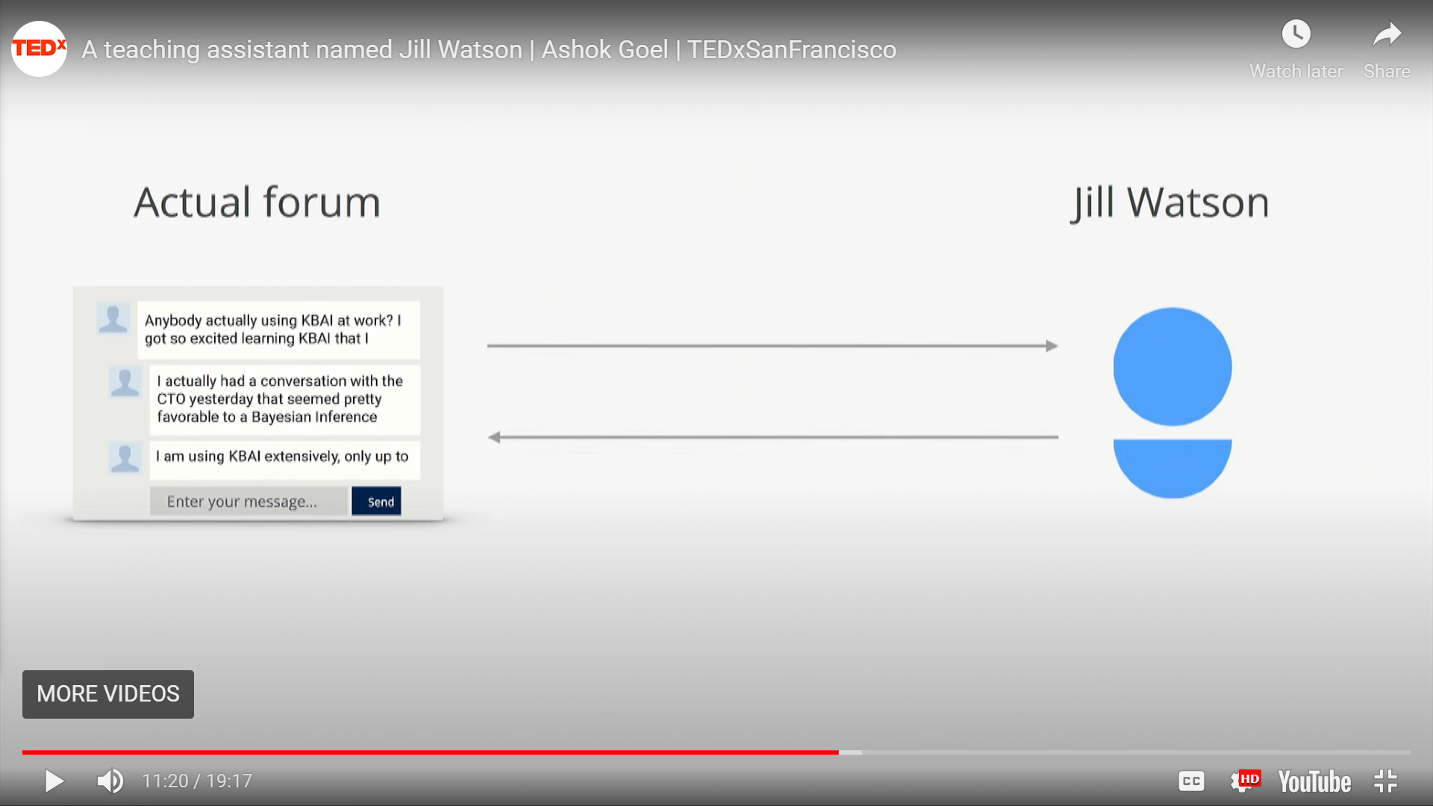

Related Work: Jill Watson
Prof. Ashok Goel
AI Teaching Assistant
Purpose: Reply forum posts automatically
Year: 2016
Place: Georgia Tech
Platform: IBM Watson

Slide 4
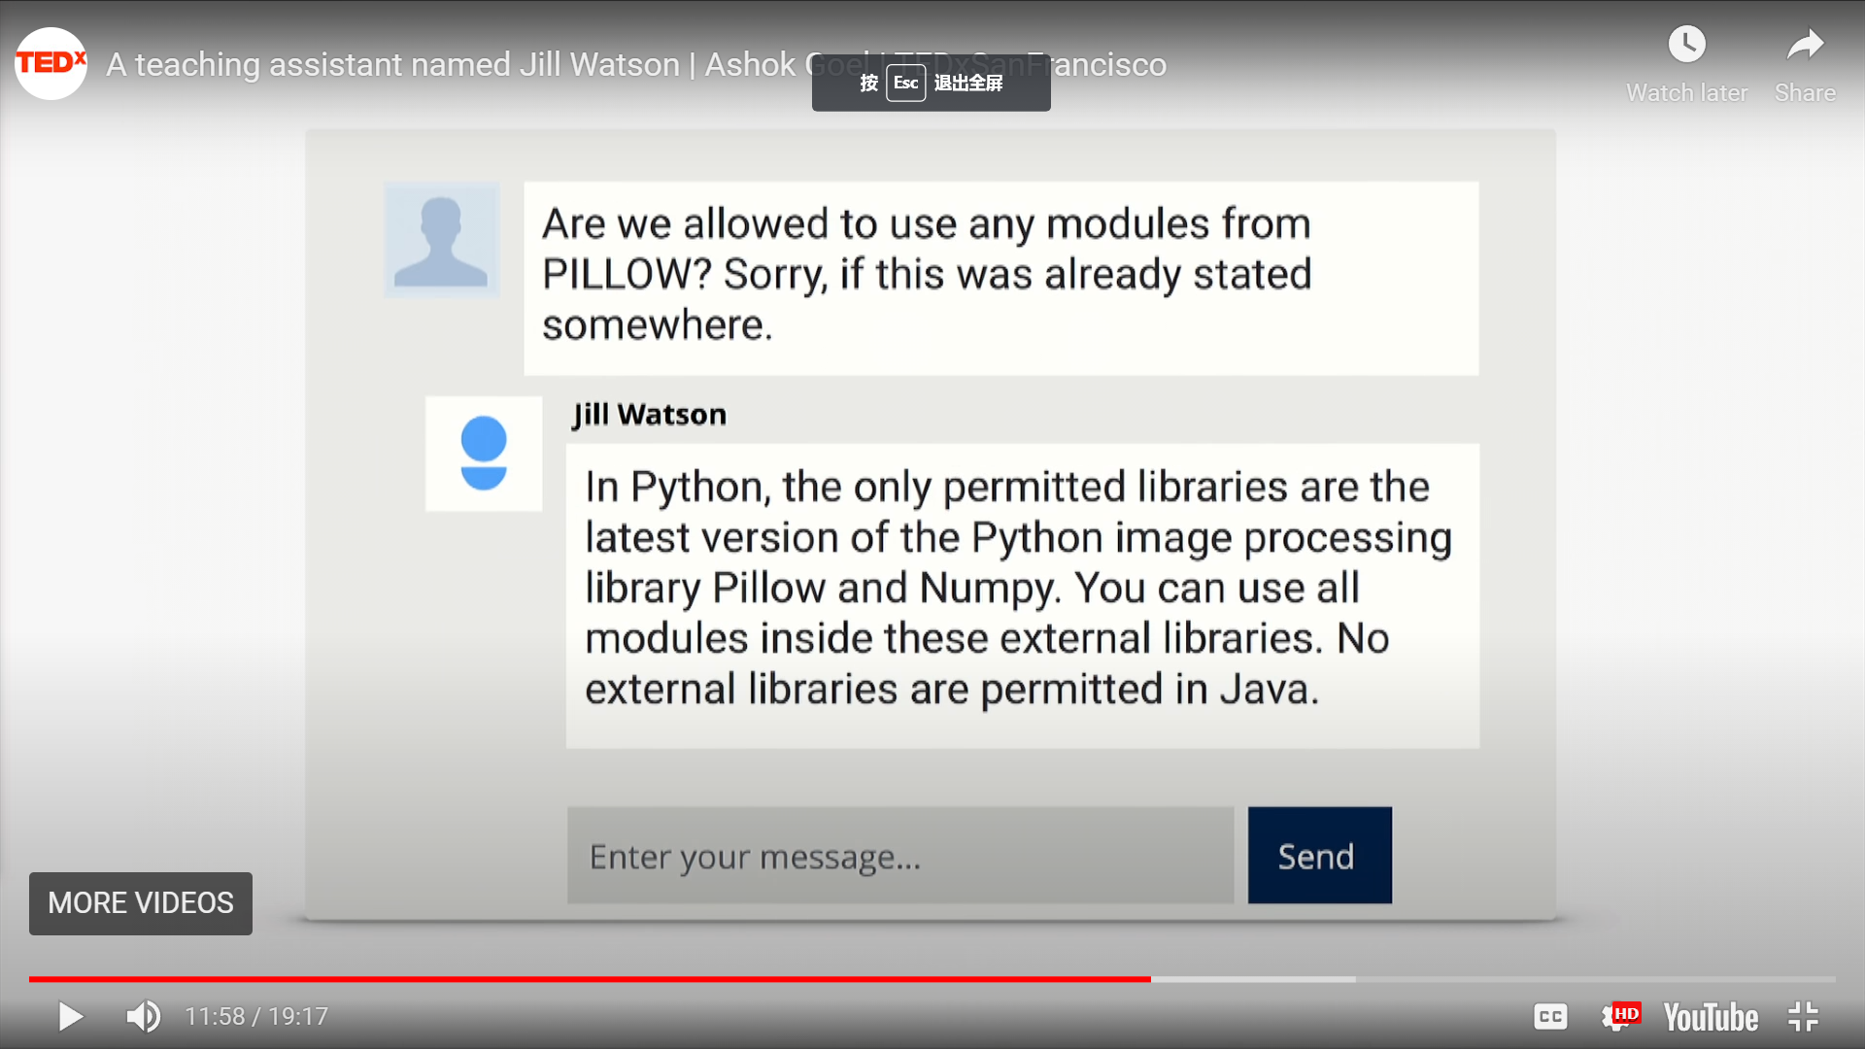
Related Work: Jill Watson

Slide 5
Related Work: Jill Watson
Highly automated
Sophisticated reply
Uni-functional
Only for replying posts

Slide 7

Our Work
AI Teaching Assistant (AITA)
Uni-functional
Multi-functional
Post Reply
Post Processing
Fully-automatic
Semi-automatic

Slide 8
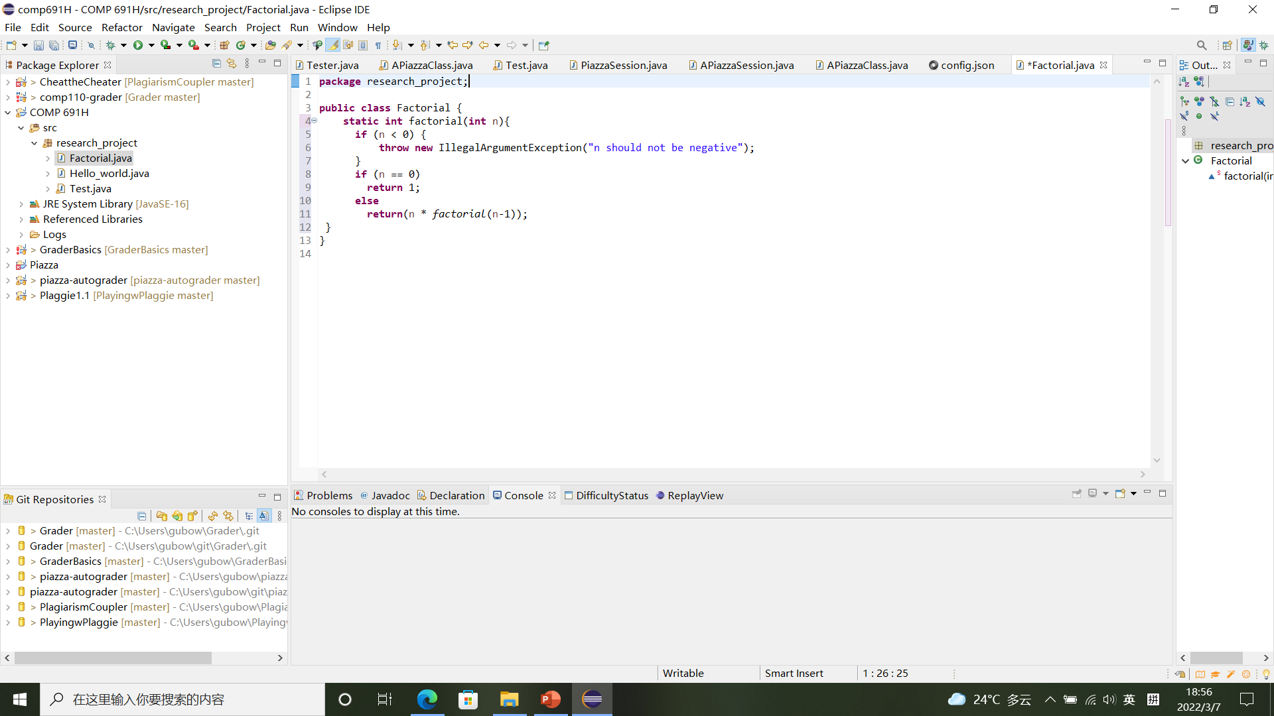
Our Work
Example: Java Factorial Function
Assignment 1: write a factorial function in Java
Input: integer n
Output: integer n!

Slide 9
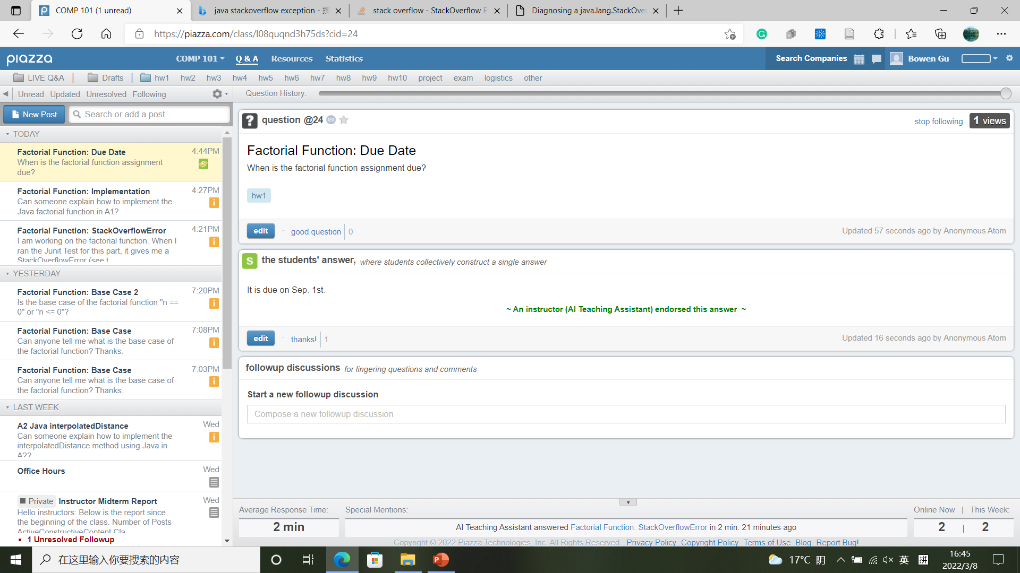
Our Work
1. Student Answer Evaluation
Student provides a good answer
Endorse satisfying student’s answer

Slide 10
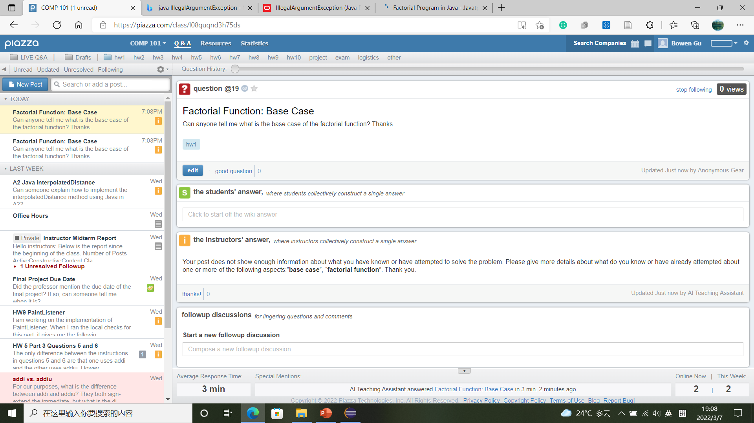
Our Work
2. Learning Suggestion
“Active” question, which directly asks for help
Request more thinking from student
Aspects are specified

Slide 11
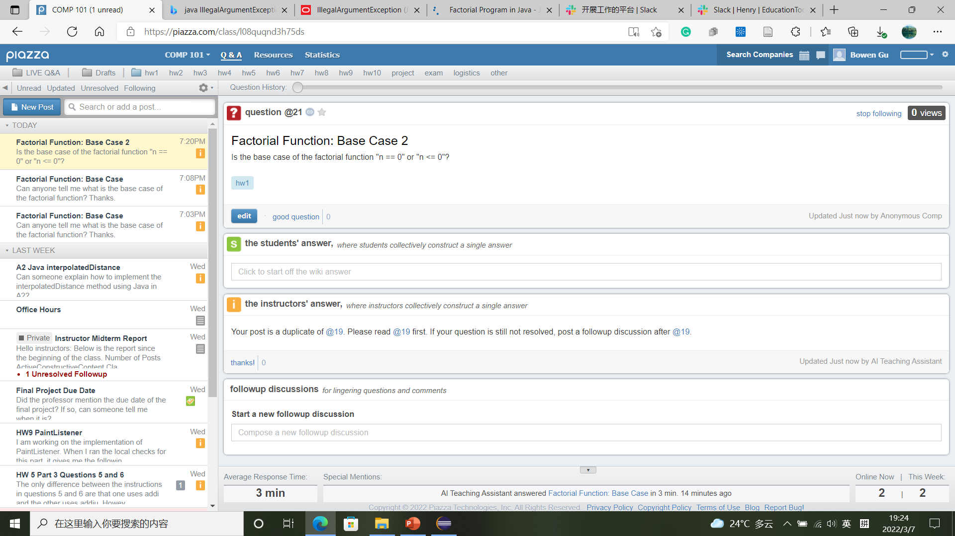
Our Work
3. Duplicate Posts Identification
Student post is a duplicate
Point to the similar post

Slide 12
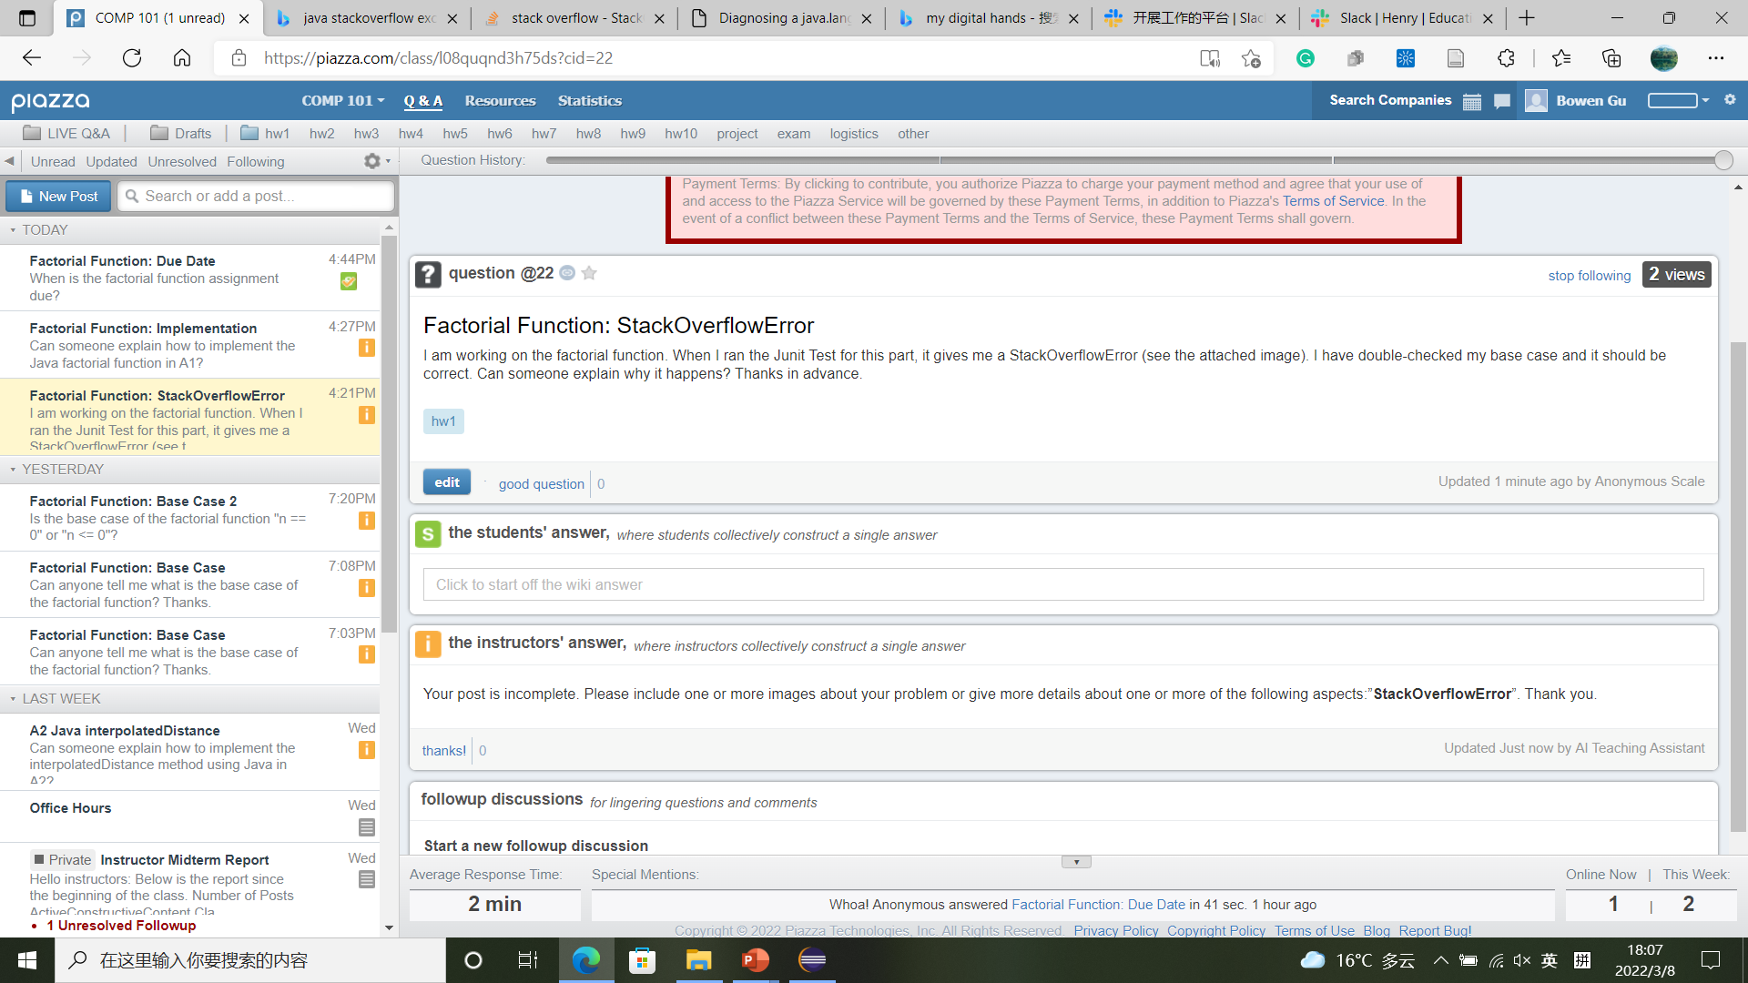
Our Work
4. Incomplete Posts Identification
Student forgot to attach the image
Inform the student to complete the post

Slide 13
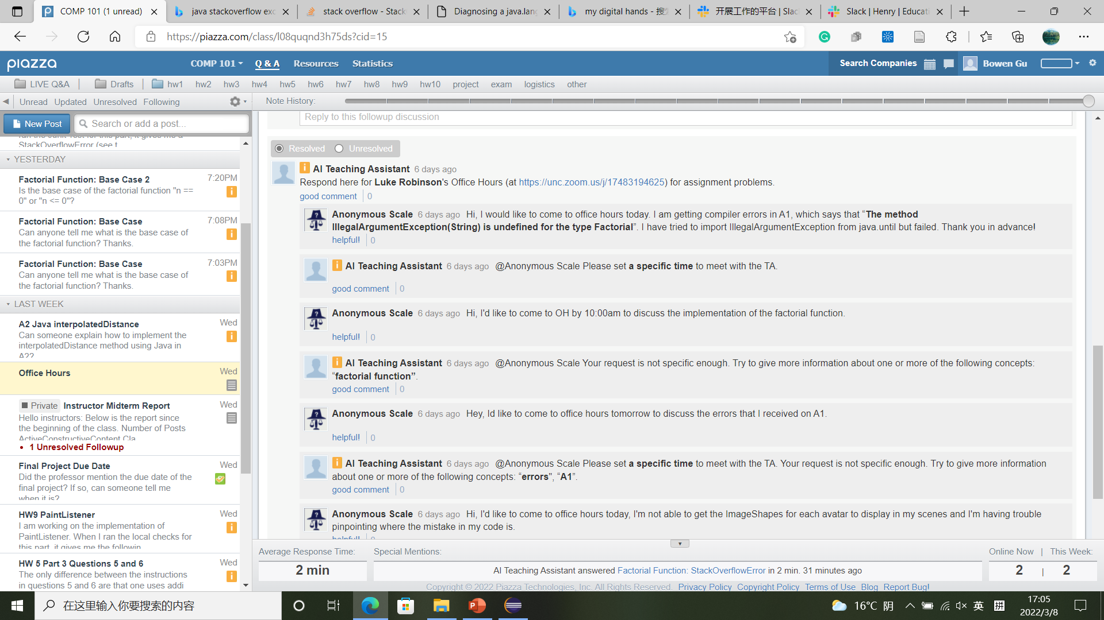


Our Work
5. Incomplete Office Hours Requests Identification
Requirement: Time + Reason
Time
Reason
Time
Reason
Time
Reason

Slide 14
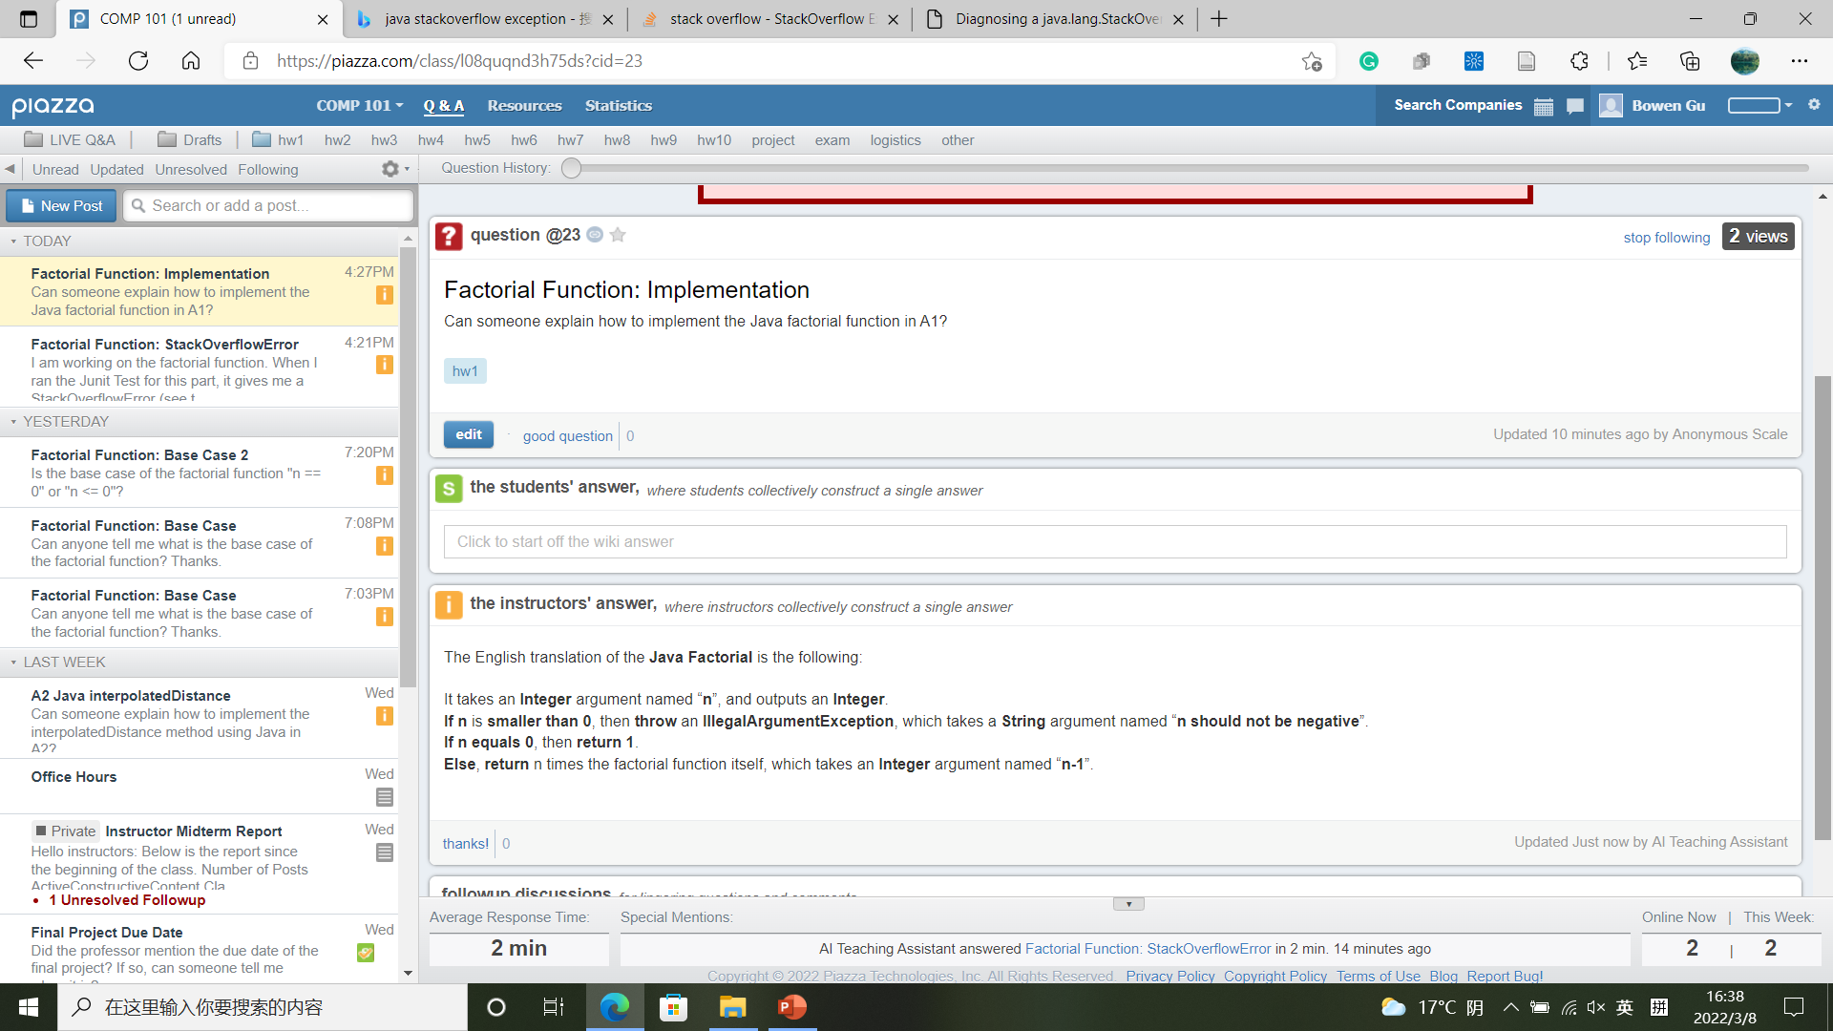
Our Work
6. Code Assignment Assist
Student ask about code implementation
Translate the solution code line by line and send to the student

Slide 15



Our Work
Before AITA Post the Response
Please confirm the proposed reply
If confirmed → AITA Post on Piazza
If rejected → Instructor edits the reply → AITA Post on Piazza
→
Instructor cancels the reply
AITA can be switched to fully-automatic mode

Slide 16
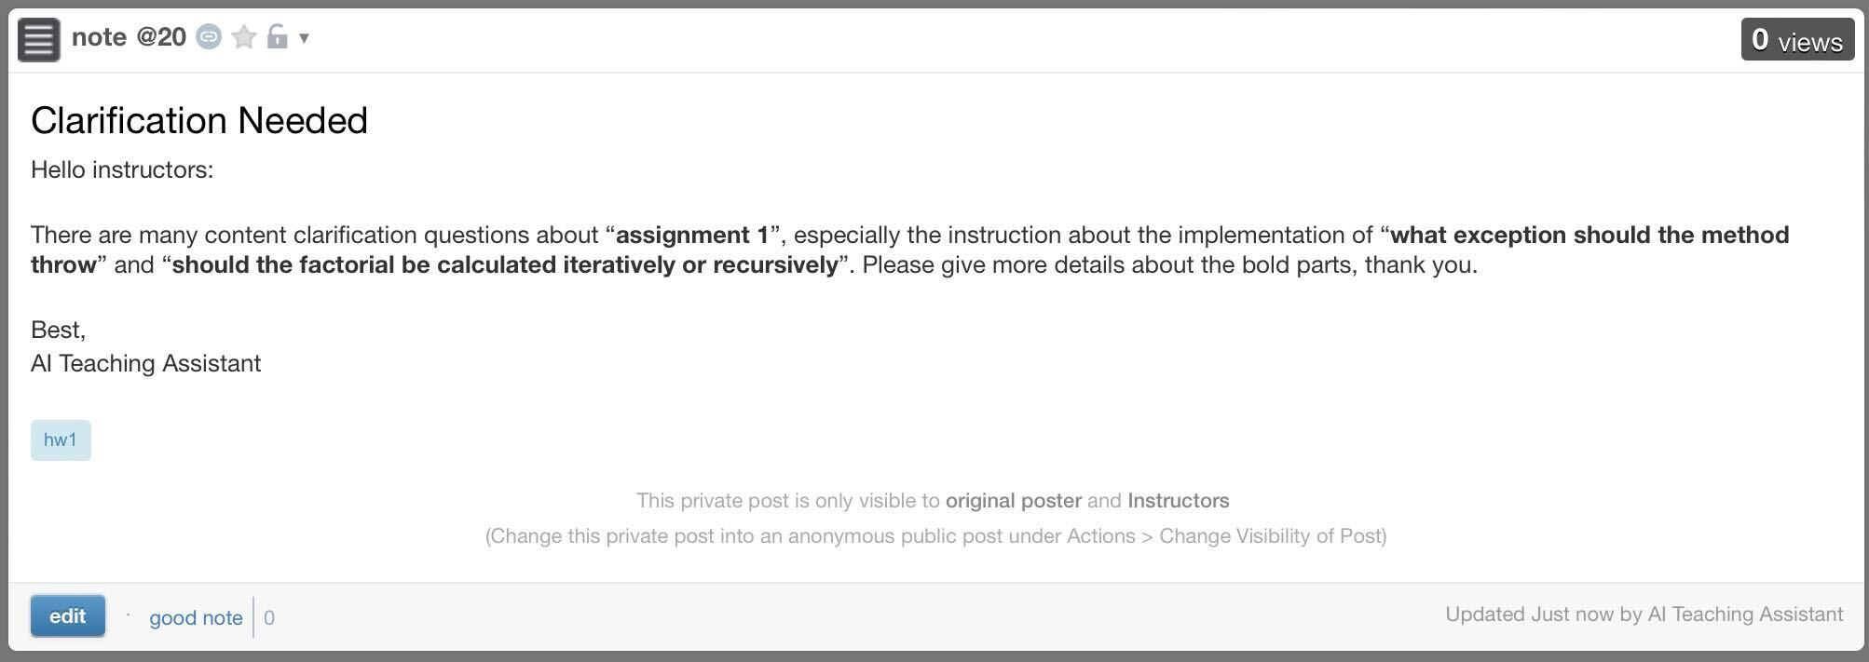
Our Work
7. Teaching Suggestion
Many “content clarification” questions
Request more clarification from the instructors
Aspects are specified
Instructors only

Slide 17
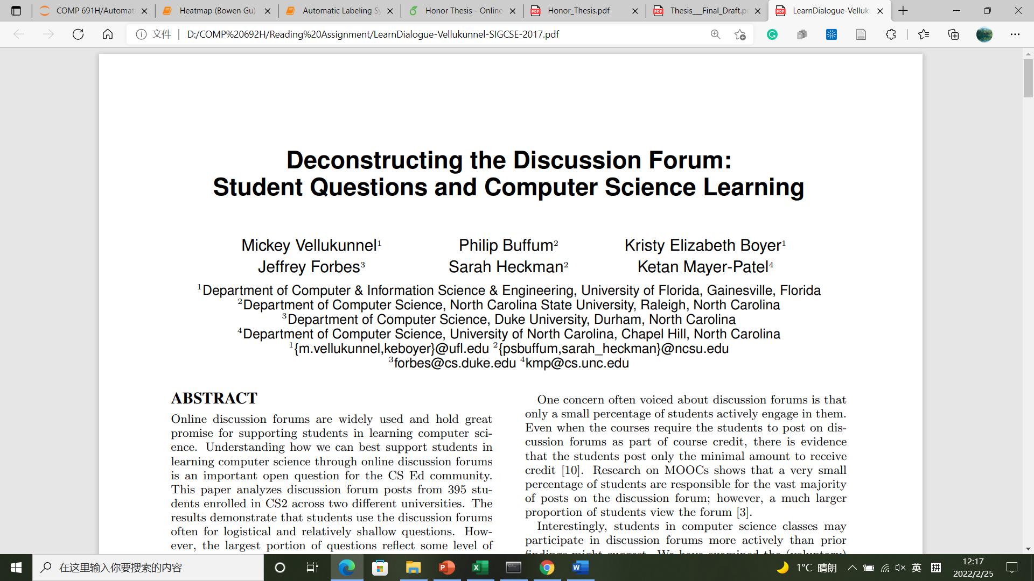
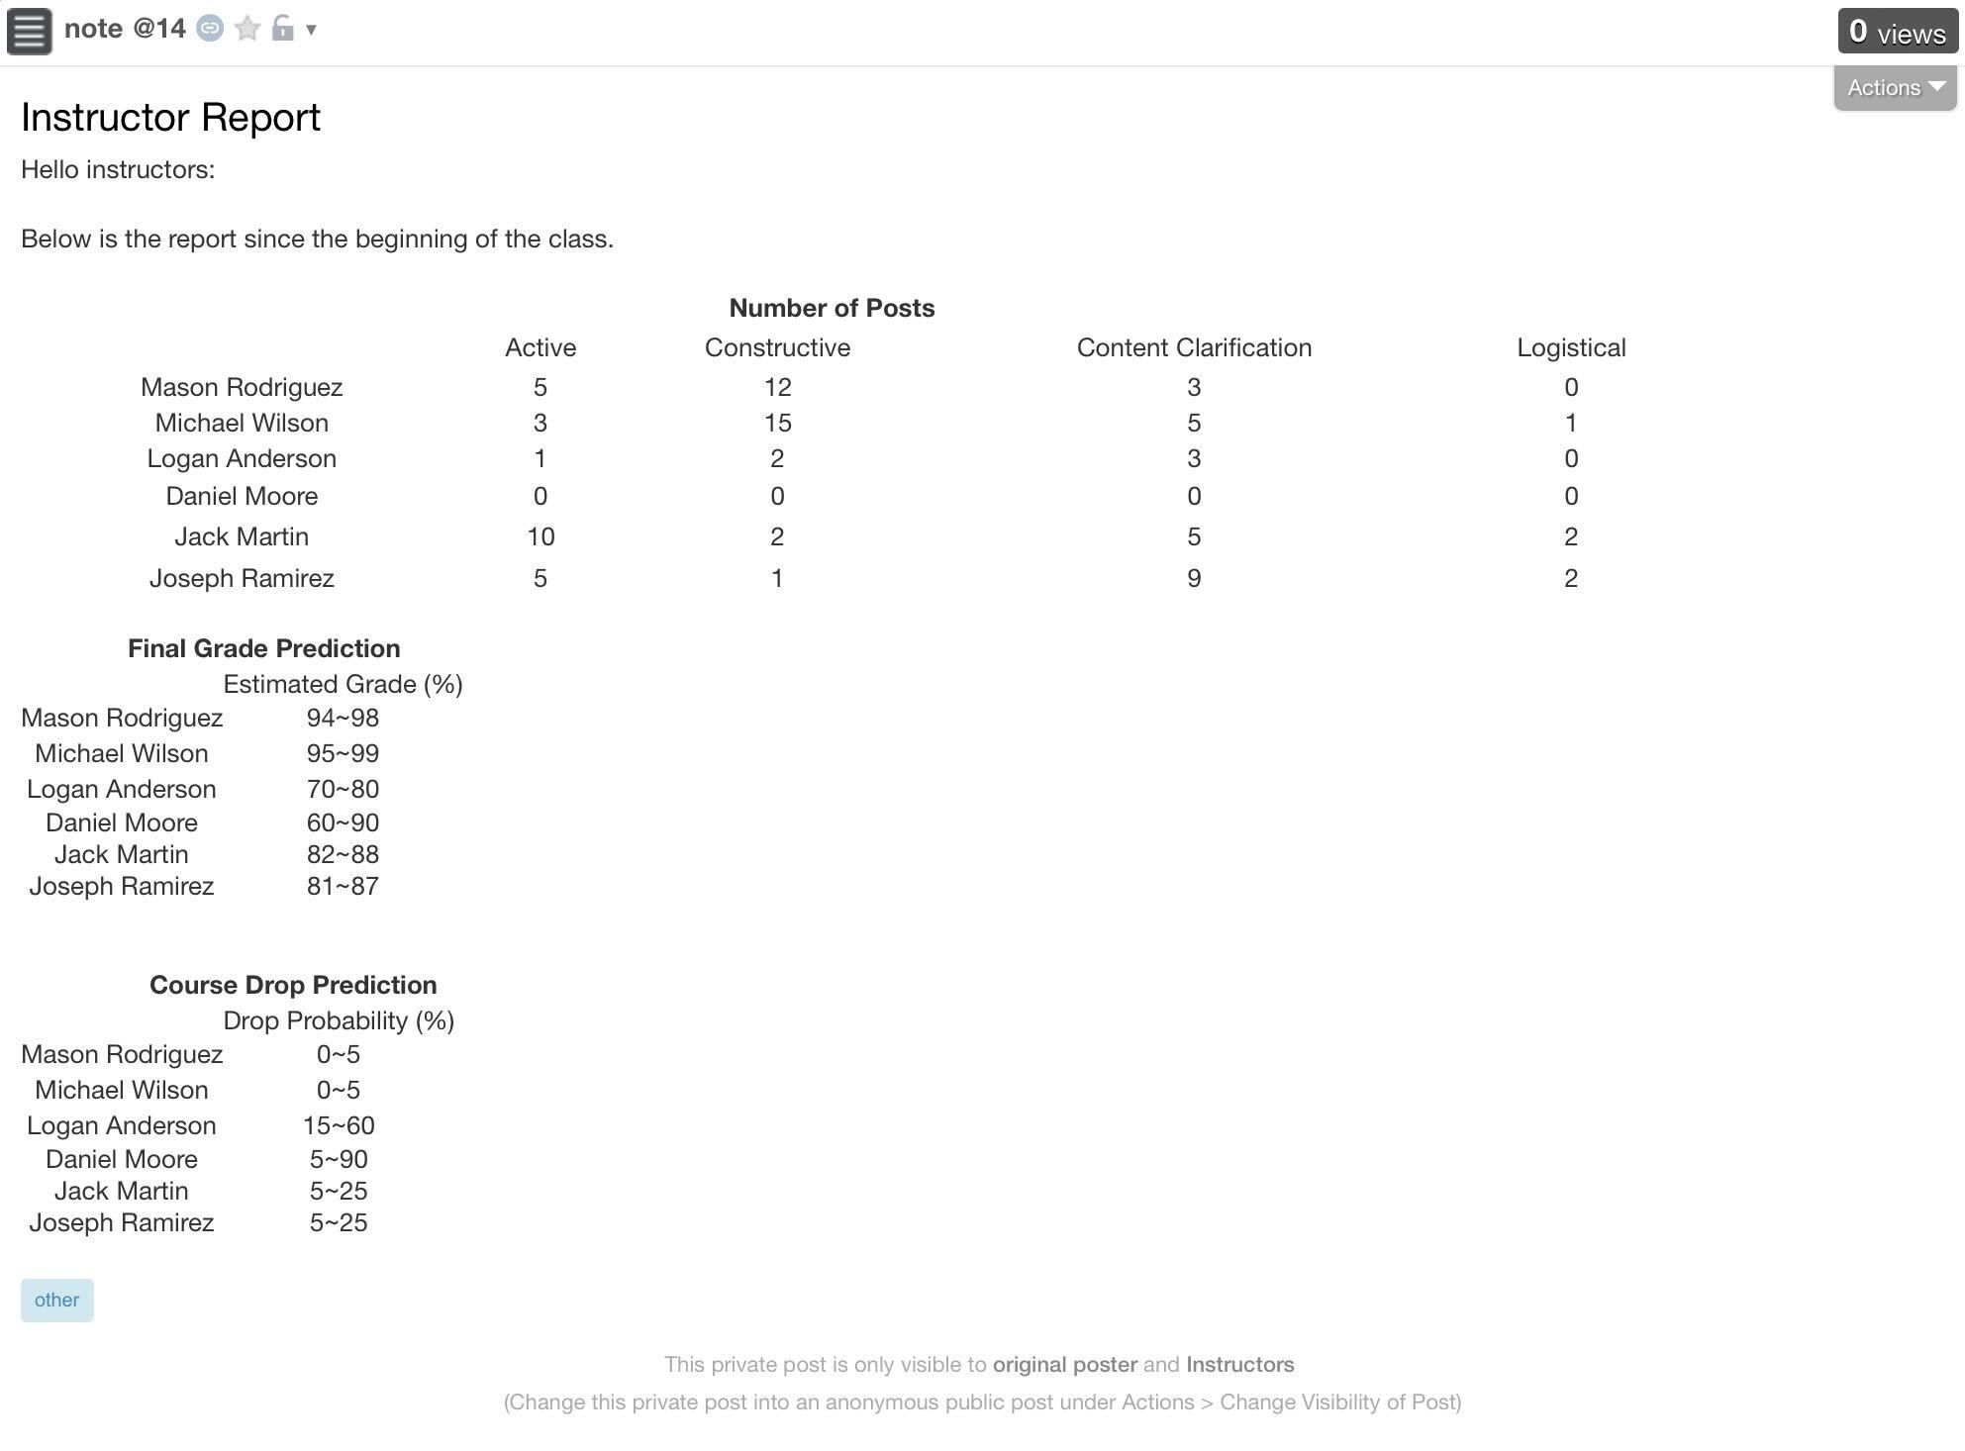
Our Work
8. Student Performance Prediction
Post statistics
No. & Type of Questions Asked
Final grade prediction
Final Grades
Course drop prediction
Instructors only
Drop Rate

Slide 18
Overview
1. Student Answer Evaluation
2. Learning Suggestion
3. Duplicate Posts Identification
4. Incomplete Posts Identification
5. Incomplete Office Hours Requests Identification
6. Code Assignment Assist
7. Teaching Suggestion
8. Student Performance Prediction
9. …

Slide 19
Overview
Database
Kernel
AI Teaching Assistant
Connection
UI

Slide 20
Overview
Kernel
1. Student Answer Evaluation
A
B
A: Automatic Labeling System
2. Learning Suggestion
Kernel
3. Duplicate Posts Identification
C
D
B: Duplicate Posts Identifier
4. Incomplete Posts Identification
5. Incomplete Office Hours Requests Identification
C: Incomplete Office Hours
Requests Identifier
6. Code Assignment Assist
Feature Extraction
Prediction Model Set Up
Data Collection
Data Cleaning
Output Predictions
7. Teaching Suggestion
8. Student Performance Prediction
D: Automatic Assignment Assistant

Slide 21
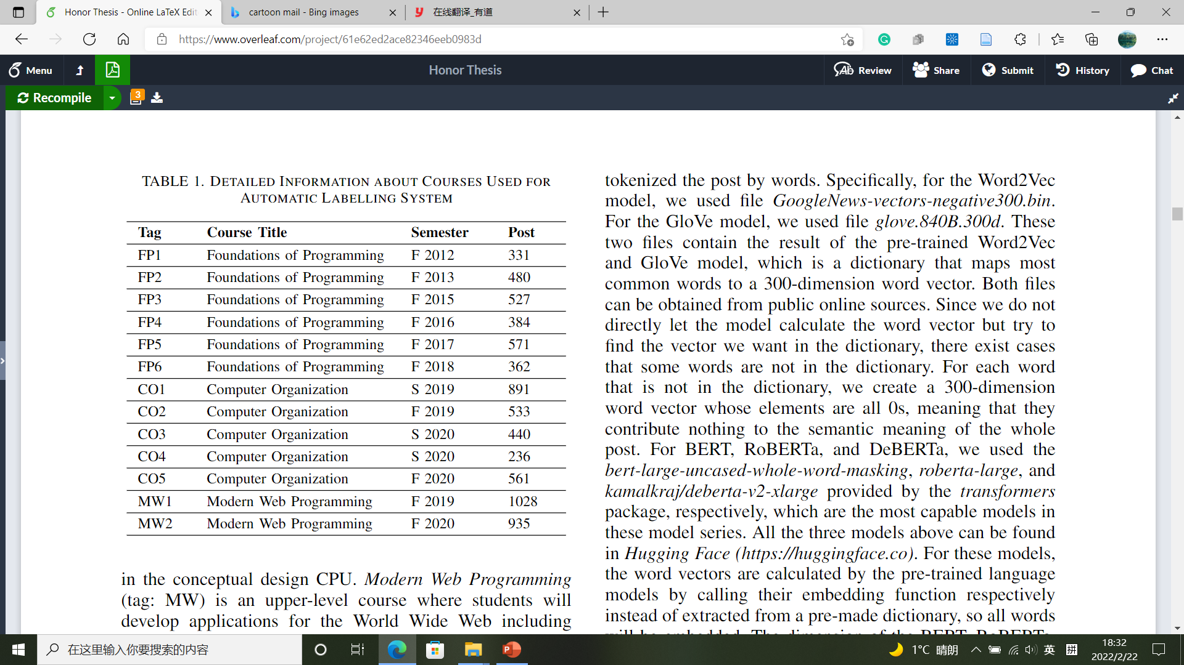
4.1 Automatic Labeling System Methodology
4.1.1 Data Collection
COMP 401
University: UNC-CH
Department: CS
Courses: 13 (6FP + 5CO + 2MW)
Posts: 7,279
COMP 411
COMP 426

Slide 22
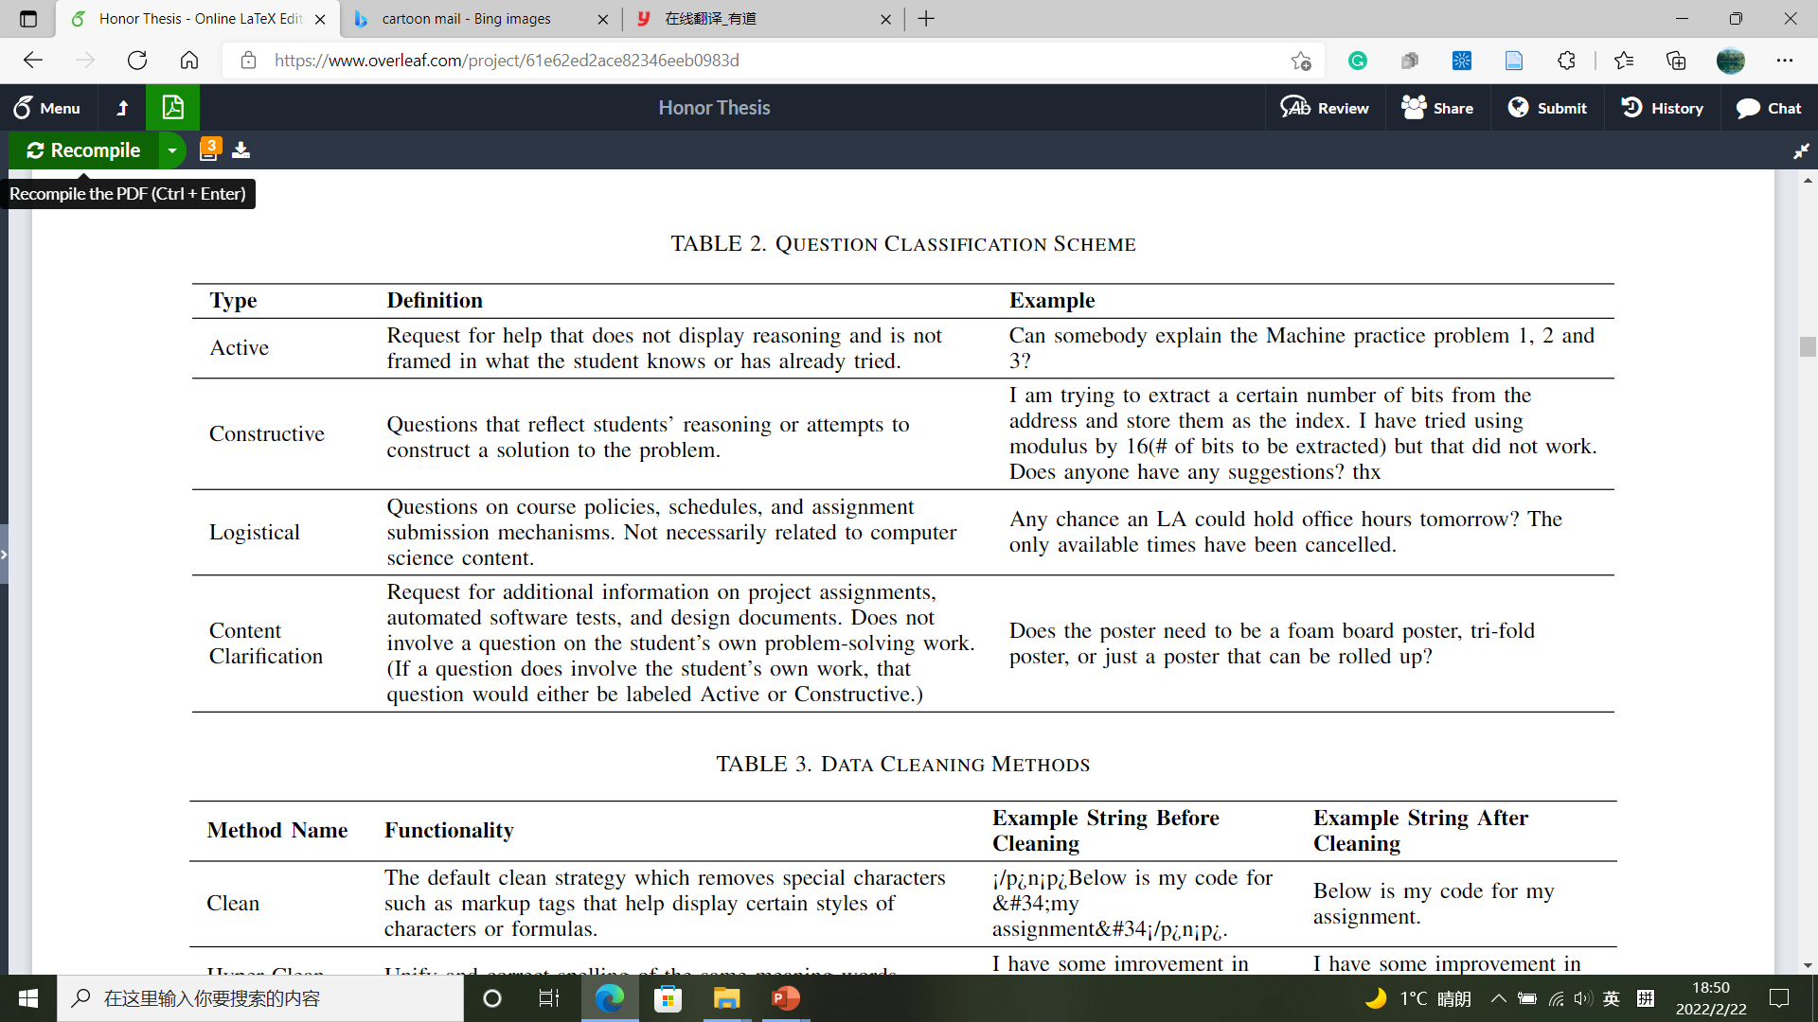
4.1 Automatic Labeling System Methodology
4.1.1 Data Collection
Post + Label

Slide 23
4.1 Automatic Labeling System Methodology
4.1.1 Data Collection
Logistical?
Y
N
Logistical
Student’s own work?
Y
N
Reasoning/Attempt?
Content
Clarification
Y
N
Constructive
Active

Slide 24
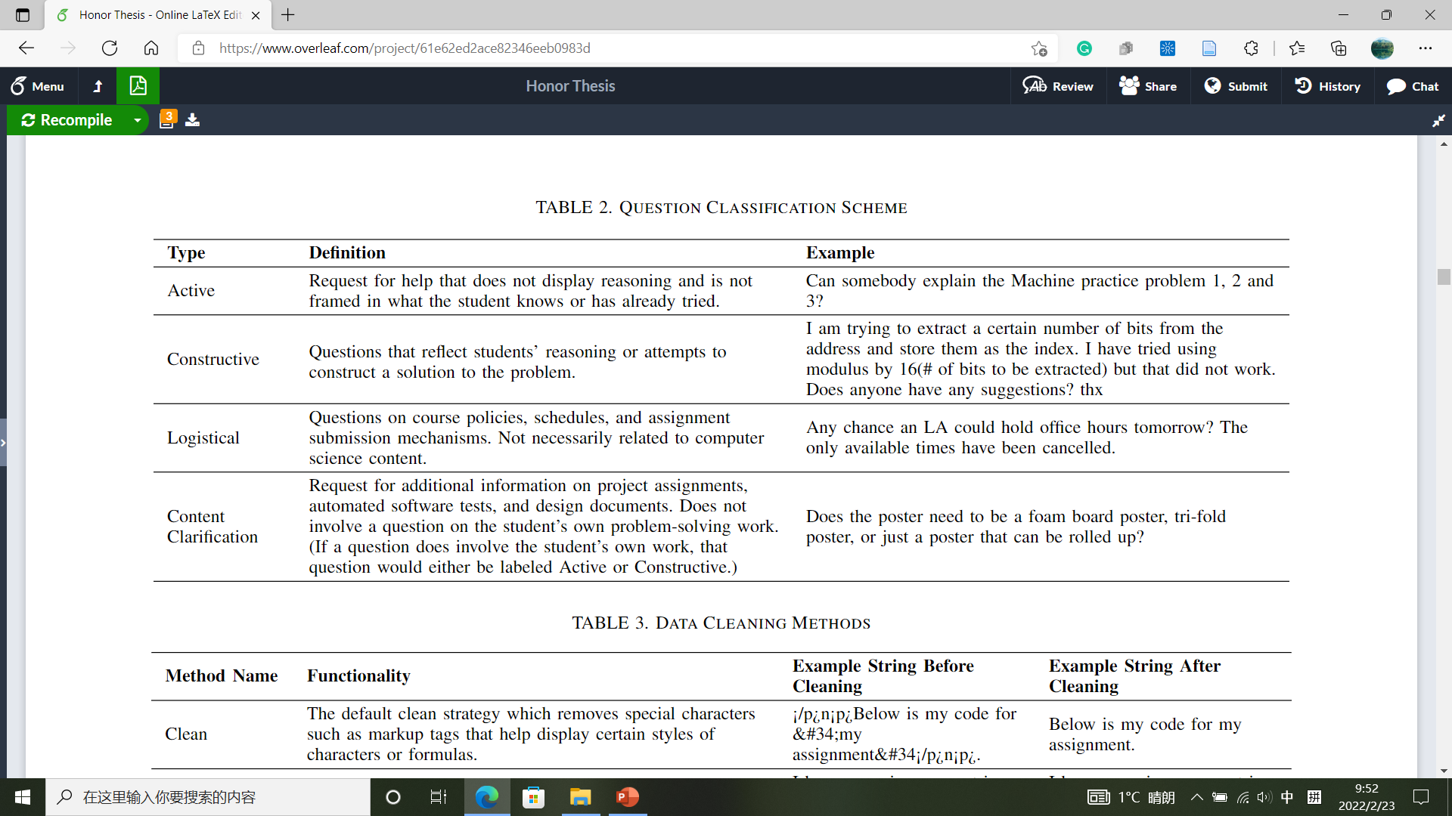
4.1 Automatic Labeling System Methodology
4.1.1 Data Collection
Mutual exclusive labels
Logistical?
Y
N
Multi-class classification
Logistical
Student’s own work?
Y
N
Reasoning/Attempt?
Content
Clarification
Y
N
Constructive
Active

Slide 25
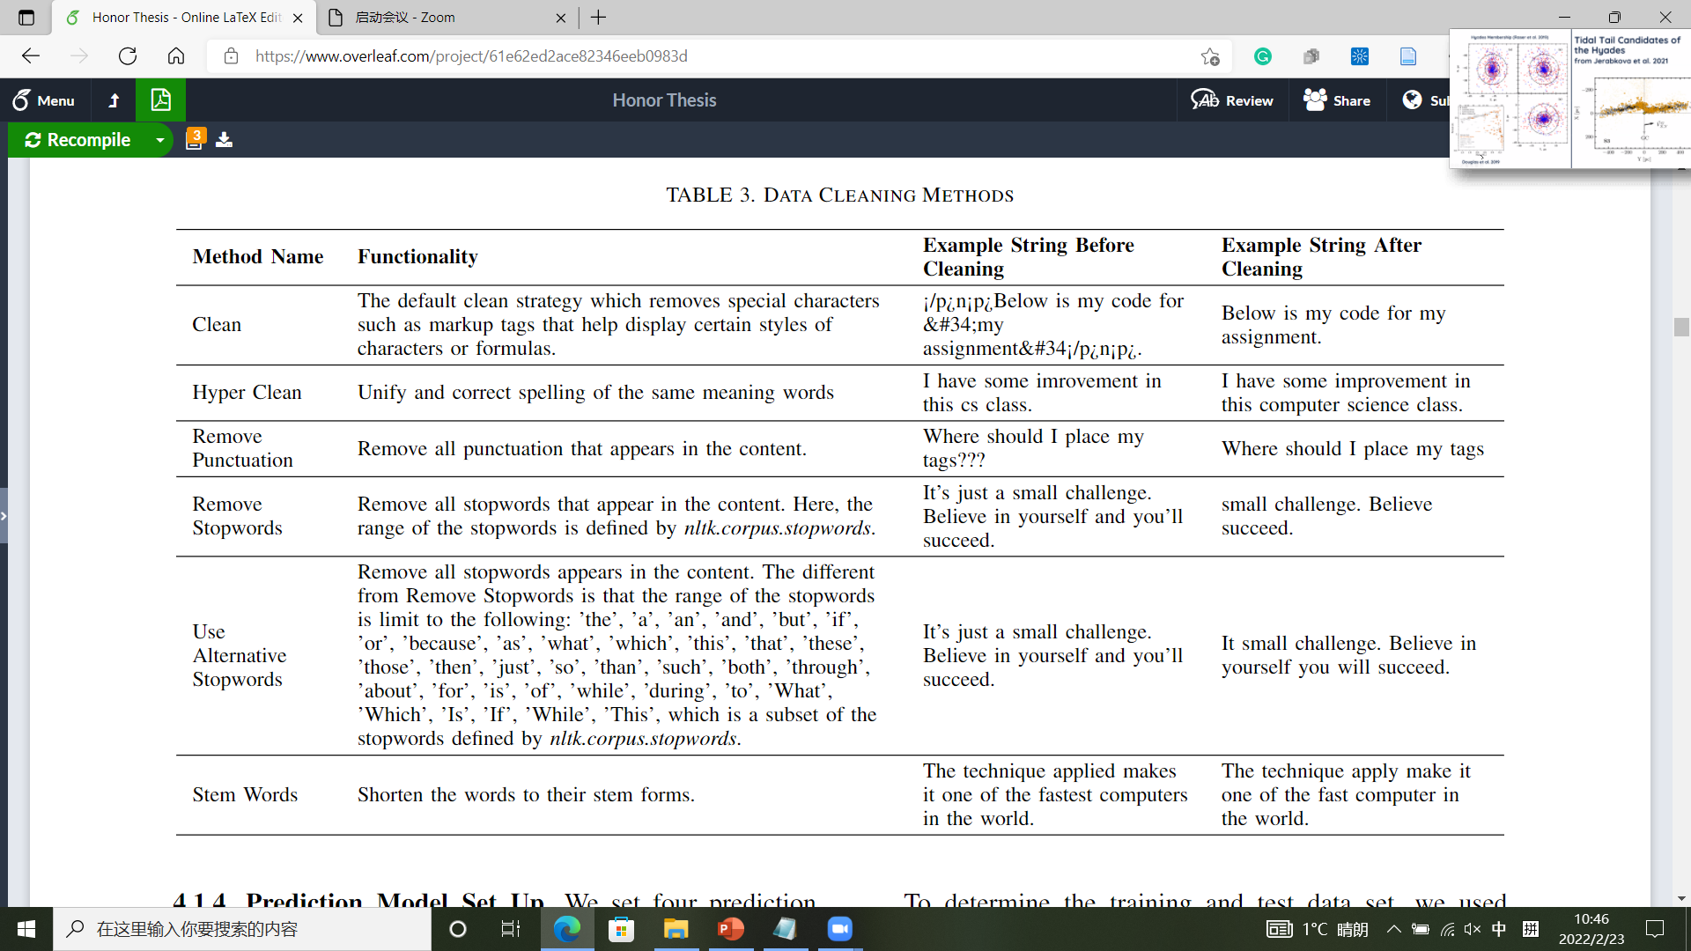
4.1 Automatic Labeling System Methodology
4.1.2 Data Cleaning
Post + Label
Cleaned Post + Label

Slide 26
4.1 Automatic Labeling System Methodology
4.1.2 Data Cleaning
More concise
More data cleaning
Greater information loss
Optimal option?
Default ON
Remove special characters
Correct spelling + unify abbr.
ON/OFF
ON
ON
Remove all punctuations
ON/OFF
ON
ON/OFF
Remove stopwords in nltk.corpus.stopwords
ON/OFF
Manually reduced stopwords set
ON
OFF
Shorten words to stems
ON/OFF

Slide 27

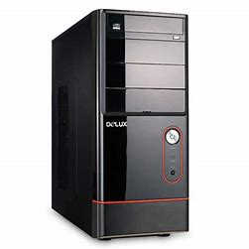
4.1 Automatic Labeling System Methodology
4.1.3 Feature Extraction
Prediction Model
Language Model
Cleaned Post + Label
Machine Learnable Post +
Label

Slide 28
4.1 Automatic Labeling System Methodology
4.1.3 Feature Extraction
Language Model
1 semantic meaning direction
}
Context
Hello
Numerical Vector
[1.0, -0.8, …, 2.1]
N elements (dimensions)
Depend on actual language model
More dimensions
Higher resolution
Better understanding

Slide 29
Language Model
4.1 Automatic Labeling System Methodology
4.1 Automatic Labeling System
4.1.3 Feature Extraction
 | Language Models
Name | Word2Vec | GloVe | BERT | RoBERTa | DeBERTa | GPT-3
Released Year | 2013 | 2014 | 2018 | 2019 | 2021 | 2020
# Parameters (most capable sub-model) | / | / | 340 M | 355 M | 1.5 B | 175 B
Vector Length (most capable sub-model) | 300 | 300 | 1,024 | 1,024 | 1,536 | 12,288
Notes:
See the thesis for language model introductions

Slide 30
4.1 Automatic Labeling System Methodology
4.1.3 Feature Extraction
Numerical Vector 1 + Label
Numerical Vector 2 + Label
Language Model
Numerical Vector 3 + Label
Cleaned Post + Label
Machine Learnable Post +
Label
Numerical Vector 4 + Label
Numerical Vector 5 + Label
Numerical Vector 6 + Label

Slide 31
4.1 Automatic Labeling System Methodology
4.1.4 Prediction Model Set Up
RFC
Results 1
Prediction Model
XGBoost
Results 2
Numerical Vector + Label
CNN
Results
Results 3
LSTM
Results 4
Notes:
See the thesis for prediction model parameter set up

Slide 32

Feature Extraction
Prediction Model Set Up
Data Collection
Data Cleaning
Output Predictions

Slide 33
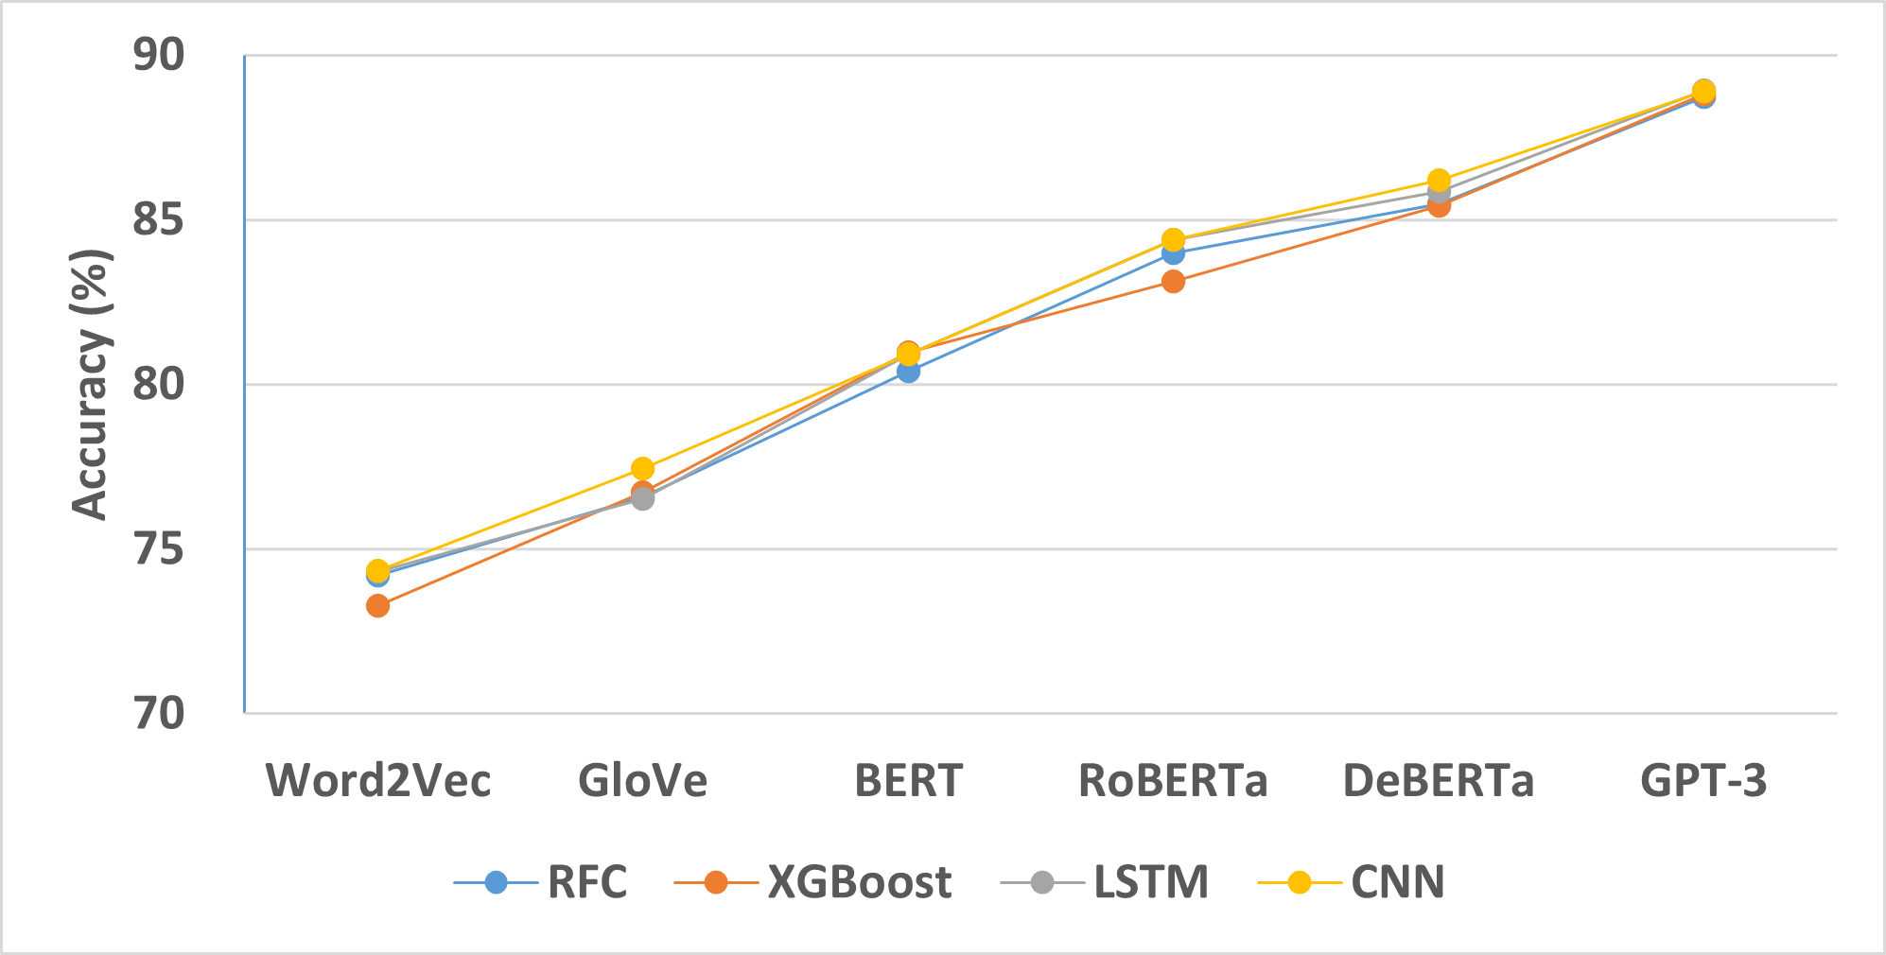
5.1 Automatic Labeling System Results
Model Accuracy (All → All)
Language model:
Increase with capability
Prediction model:
Little difference
CNN slightly better
XGBoost slightly worse
Training Data:
80% of all posts
Test Data:
20% of all posts

Slide 34
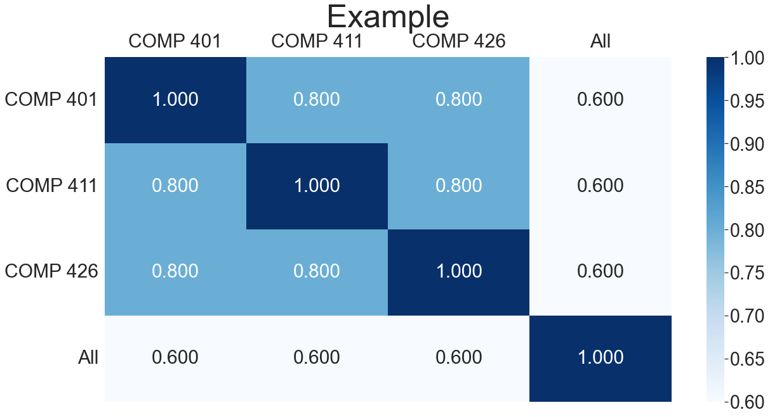
5.1 Automatic Labeling System Results
Heat Map (CNN)
X-axis: Test data
COMP 401
COMP 411
Y-axis: Training data
COMP 426
All =
COMP 401
+
COMP 411
+
COMP 426
Case 1: Train = 80% course group posts
Test = 20% course group posts
Example 1: Train = 80% COMP 401 posts
Test = 20% COMP 401 posts
Case 2: Train = 100% course group 1 posts
Test = 100% course group 2 posts
Example 2: Train = 100% COMP 401 posts
Test = 100% COMP 411 posts
Case 3: Non-All = 100% course group posts
All = All posts – non-All group posts
Example 4: Train = 100% COMP 411 + COMP 426 posts
Test = 100% COMP 401 posts
Example 3: Train = 100% COMP 401 posts
Test = 100% COMP 411 + COMP 426 posts

Slide 35
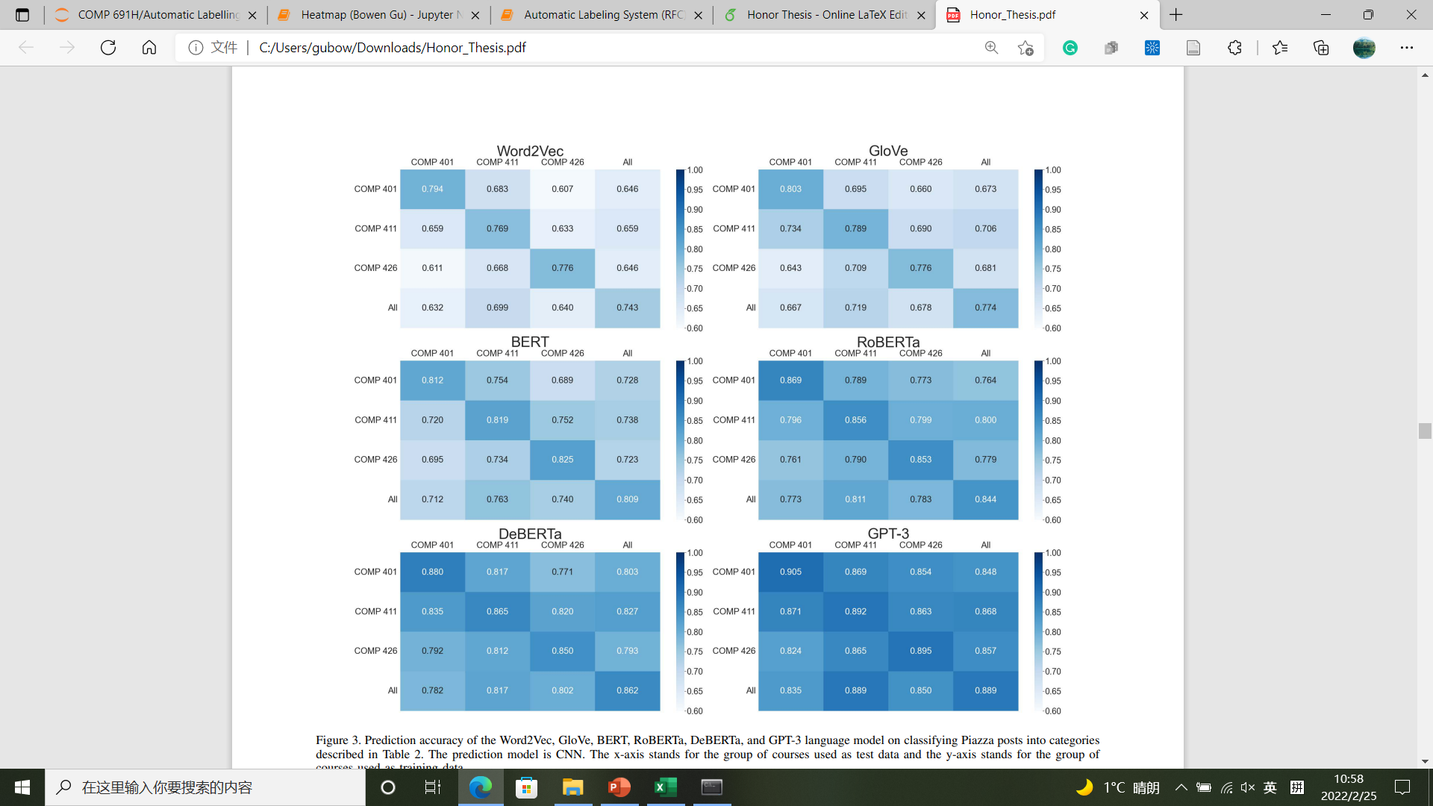
5.1 Automatic Labeling System Results
Heat Map (CNN)
COMP 401
COMP 411
COMP 426
All =
COMP 401
+
COMP 411
+
COMP 426

Slide 36
Kernel
A
B
A: Automatic Labeling System
C
D
B: Duplicate Posts Identifier
C: Incomplete Office Hours
Requests Identifier
Feature Extraction
Prediction Model Set Up
Data Collection
Data Cleaning
Output Predictions
D: Automatic Assignment Assistant

Slide 37
Feature Extraction
Prediction Model Set Up
Data Collection
Data Cleaning
Output Predictions

Slide 38


4.2 Duplicate Posts Identifier Methodology
4.2.1 Data Collection
Hard to find duplicates
Existing human expert labeled data

Slide 39
4.2 Duplicate Posts Identifier Methodology
4.2.1 Data Collection
ID | Question 1 | Question 2 | Duplicate?
1 | … | … | 1
2 | … | … | 0
3 | … | … | 0
4 | … | … | 1
5 | … | … | 0
6 | … | … | 1
… | … | … | ..
Binary classification
Question pairs: 404,290
Label already provided
Positive rate ≈ 36%

Slide 40
4.2 Duplicate Posts Identifier Methodology
4.2.3 Feature Extraction
Numerical Vector 1 + Label
Numerical Vector 1 + Other Feature 1 + Label
Numerical Vector 2 + Label
Numerical Vector 2 + Other Feature 2 + Label
Numerical Vector 3 + Label
Numerical Vector 3 + Other Feature 3 + Label
Cleaned Question Pairs + Label
Numerical Vector 4 + Label
Numerical Vector 4 + Other Feature 4 + Label
Numerical Vector 5 + Label
Numerical Vector 5 + Other Feature 5 + Label
Numerical Vector 6 + Label
Numerical Vector 6 + Other Feature 6 + Label

Slide 41
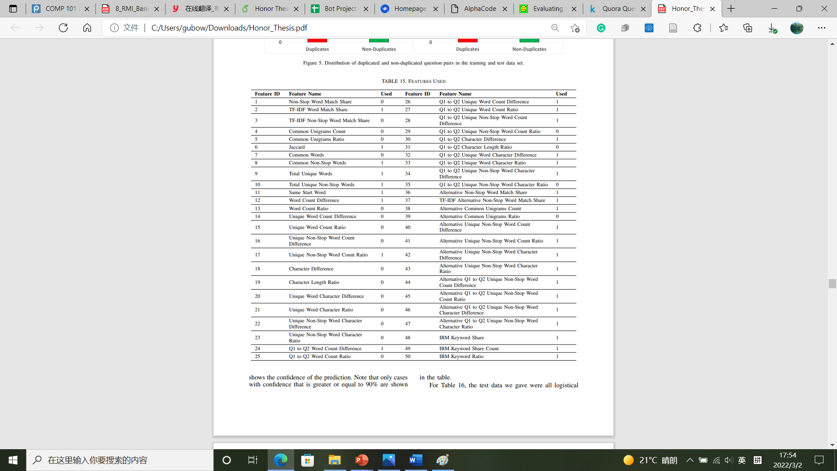
4.2 Duplicate Posts Identifier Methodology
4.2.3 Feature Extraction
For definitions, see paper Table 4, 5, and 6
PCA
50 features
30 features
95% feature coverage
IBM Watson

Slide 42
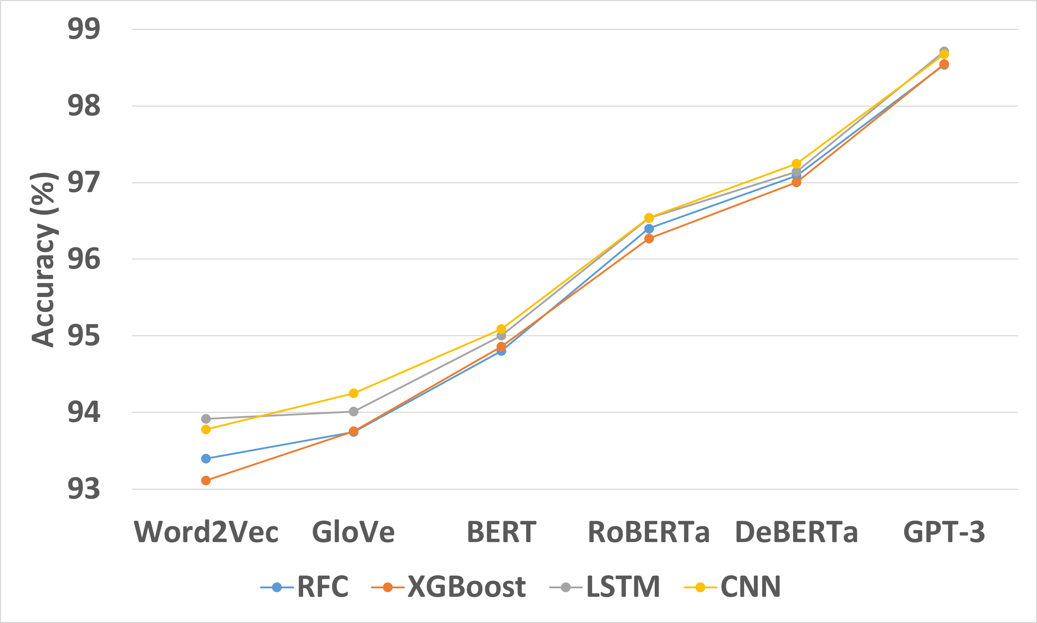
5.2 Duplicate Posts Identifier Results
Model Accuracy
Language model:
Increase with capability
Accuracy:
Higher than automatic labeling system
Prediction model:
Neural network models slightly better
than Non-neural network models
Almost no difference in
capable language models
Question pairs: 404,290
Training data: First 400,000
Test data: Rest 4,290

Slide 43
5.2 Duplicate Posts Identifier Results
Test on Piazza
Model: GPT-3 + CNN

Slide 44
5.2 Duplicate Posts Identifier Results
Test on Piazza
Logistical Posts
Post 1 | Post 2 | Source 1 | Source 2 | Confidence (%)
What should we watch/study to prepare for the midterm on Monday? | I was wondering how I can prepare for the midterm? Should we just look at the quiz and prepare based on it? | COMP 401 Fall 2015 | COMP 401 Fall 2015 | 94.291
Non-logistical Posts
Post 1 | Post 2 | Source 1 | Source 2 | Confidence (%)
Does the knight have to “walk” into the gorge or across the bridge, or can it just appear? | Can we make the knight appear on the bridge scene instead of walking across the bridge? | COMP 401 Fall 2013 | COMP 401 Fall 2015 | 96.366
Different Semester

Slide 45
5.2 Duplicate Posts Identifier Results
Test on Piazza
Complicated Non-logistical Posts
Post 1 | Post 2 | Source 1 | Source 2 | Confidence (%)
I keep getting this error: “W***public void grail.ABridgeScene. addPropertyChangeListener (java.beans.PropertyChangeListener) should be associated with annotation: @ObserverRegisterer (Property Listener)” However, when I add the annotation “@ObserverRegisterer(Property Listener)” it keeps giving me errors? | I’m getting the following warnings: W***public void grail.composites.AGorge. addPropertyChangeListener (java.beans.PropertyChangeListener) should be associated with annotation: @ObserverRegisterer (Property Listener). Are we able to safely ignore this without losing points? | COMP 401 Fall 2015 | COMP 401 Fall 2016 | 96.995

Slide 46
Kernel
A
B
A: Automatic Labeling System
C
D
B: Duplicate Posts Identifier
C: Incomplete Office Hours
Requests Identifier
Feature Extraction
Prediction Model Set Up
Data Collection
Data Cleaning
Output Predictions
D: Automatic Assignment Assistant

Slide 47
Feature Extraction
Prediction Model Set Up
Data Collection
Data Cleaning
Output Predictions

Slide 48
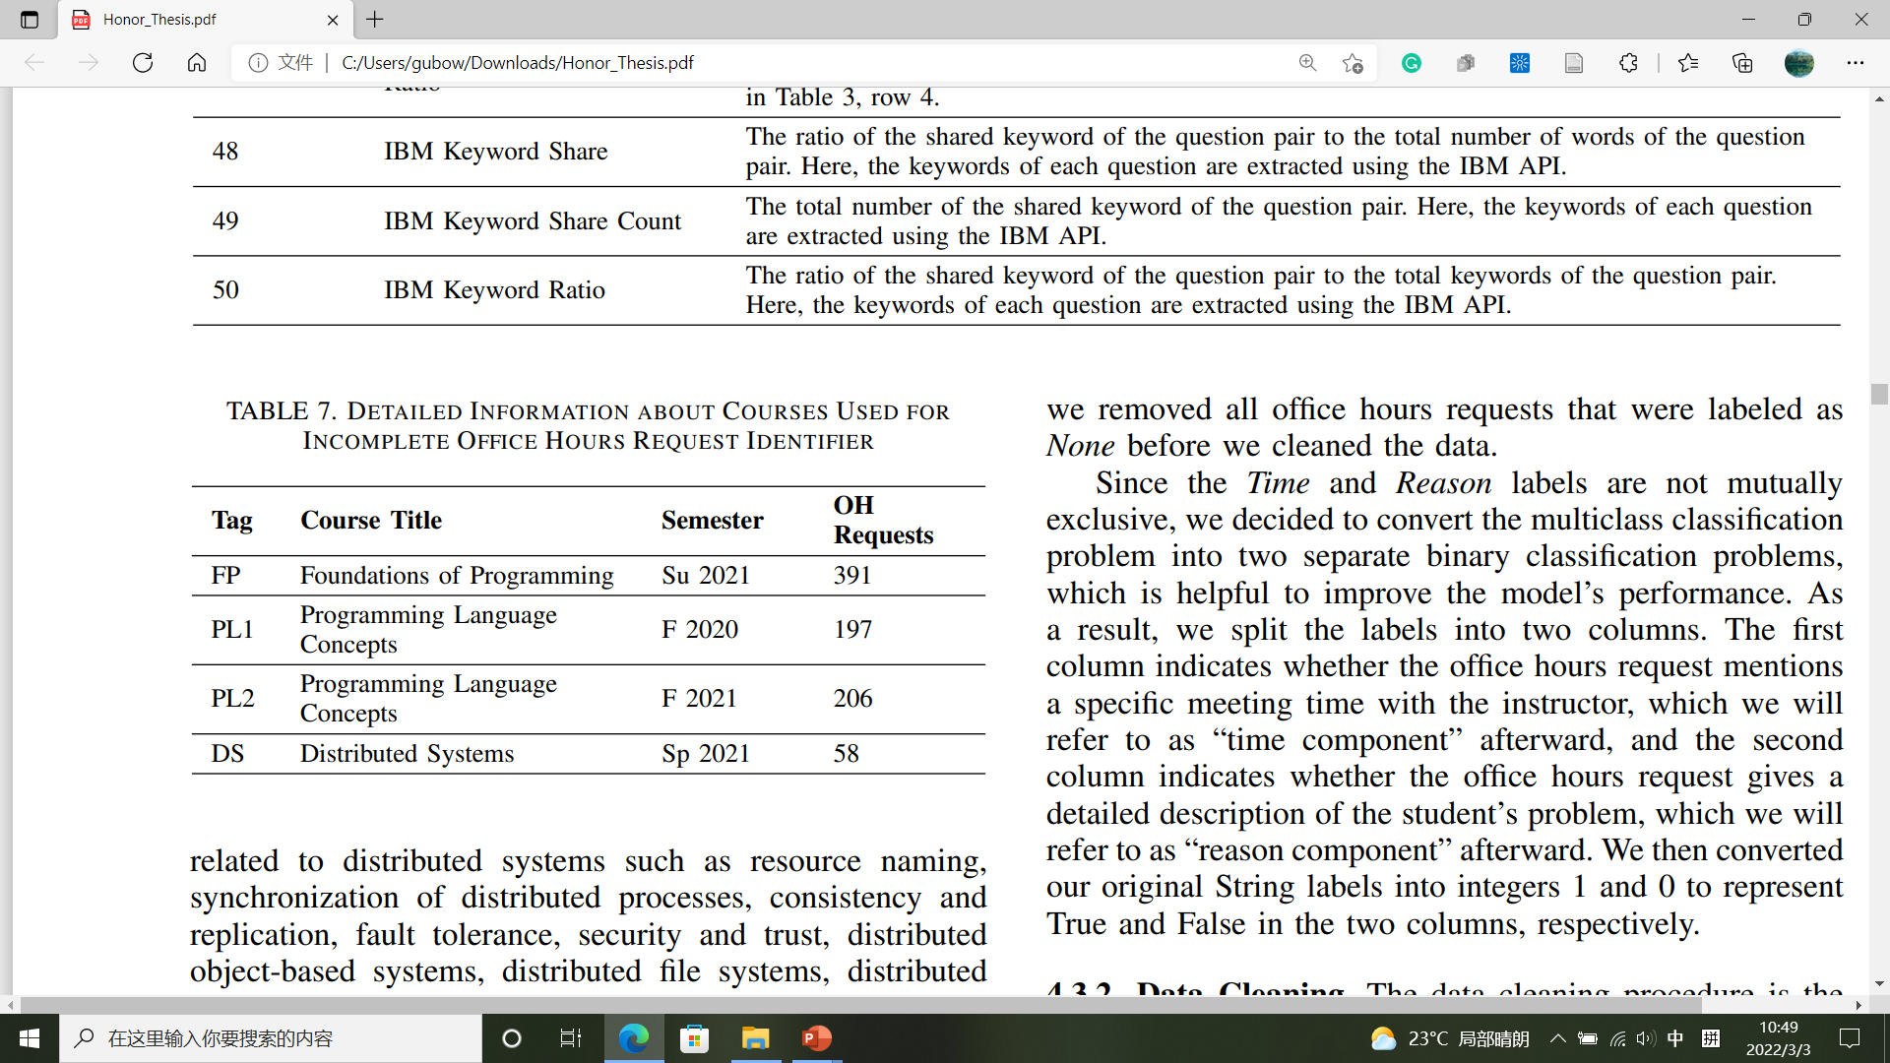
4.3 Incomplete Office Hours Requests Identifier Methodology
4.3.1 Data Collection
No office hours request data
University: UNC-CH
Department: CS
Courses: 4 (1FP + 2PL + 1DS)
OH requests: 852

Slide 49
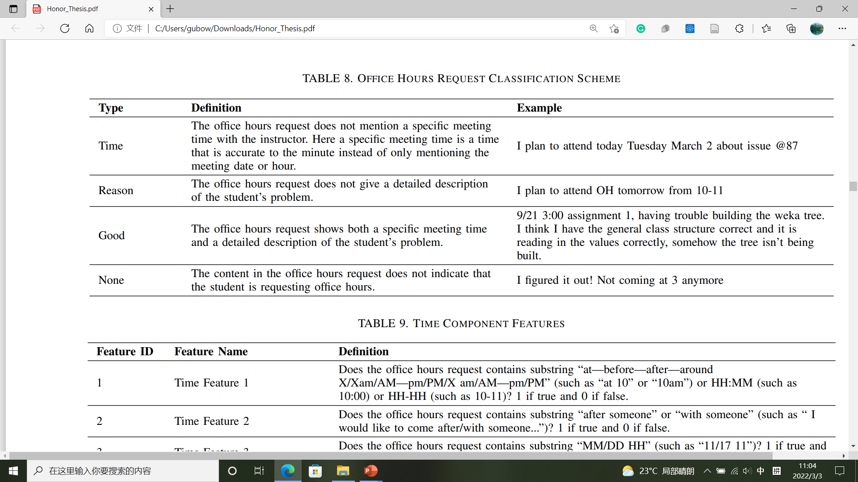
4.3 Incomplete Office Hours Requests Identifier Methodology
4.3.1 Data Collection
Request + Label

Slide 50
4.3 Incomplete Office Hours Requests Identifier Methodology
4.3.1 Data Collection
Specific Time
Specific Reason
Specific Time
Specific Reason
Specific Time
Specific Reason
Not a request
“None” requests will be removed after this step
Specific Time
Time + Reason
Specific Reason

Slide 51
4.3 Incomplete Office Hours Requests Identifier Methodology
4.3.1 Data Collection
4.1
4.3
ID | Request | Label
1 | … | Time
2 | … | Reason
3 | … | Good
4 | … | Time + Reason
Mutual exclusive labels
Non-mutual exclusive labels
Multi-class classification
Multiple binary classification
ID | Request | Label | Time? | Reason?
1 | … | Time | 1 | 0
2 | … | Reason | 0 | 1
3 | … | Good | 0 | 0
4 | … | Time + Reason | 1 | 1
2 independent binary classification

Slide 52
4.3 Incomplete Office Hours Requests Identifier Methodology
4.3.3 Feature Extraction
Numerical Vector 1 + Other Feature 1 + Label
Numerical Vector 2 + Other Feature 2 + Label
Numerical Vector 3 + Other Feature 3 + Label
Cleaned Request + Label
Numerical Vector 4 + Other Feature 4 + Label
Numerical Vector 5 + Other Feature 5 + Label
Numerical Vector 6 + Other Feature 6 + Label

Slide 53
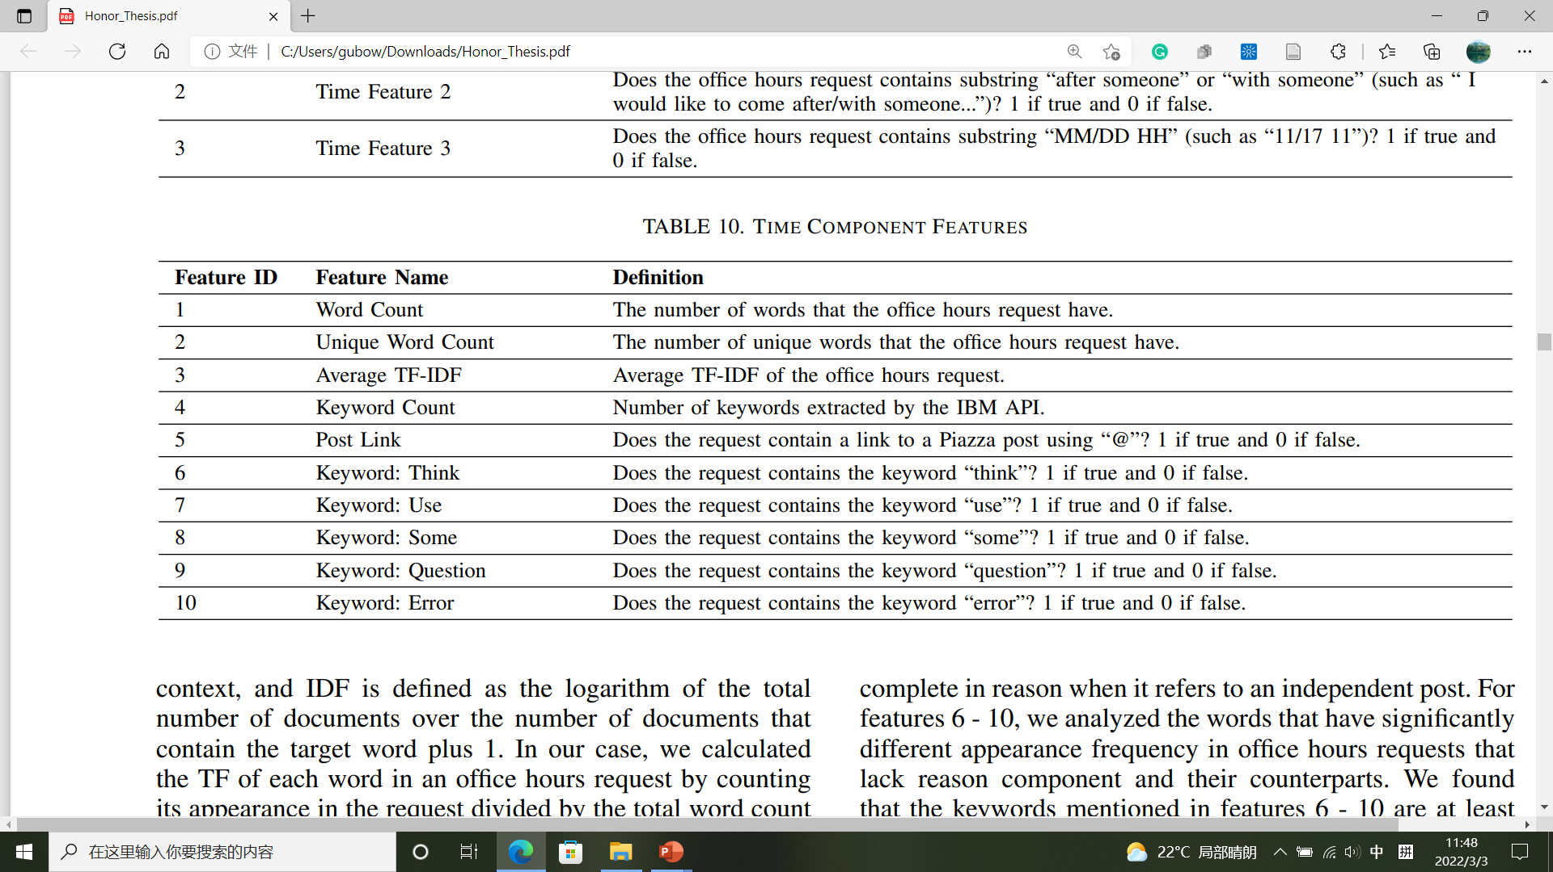
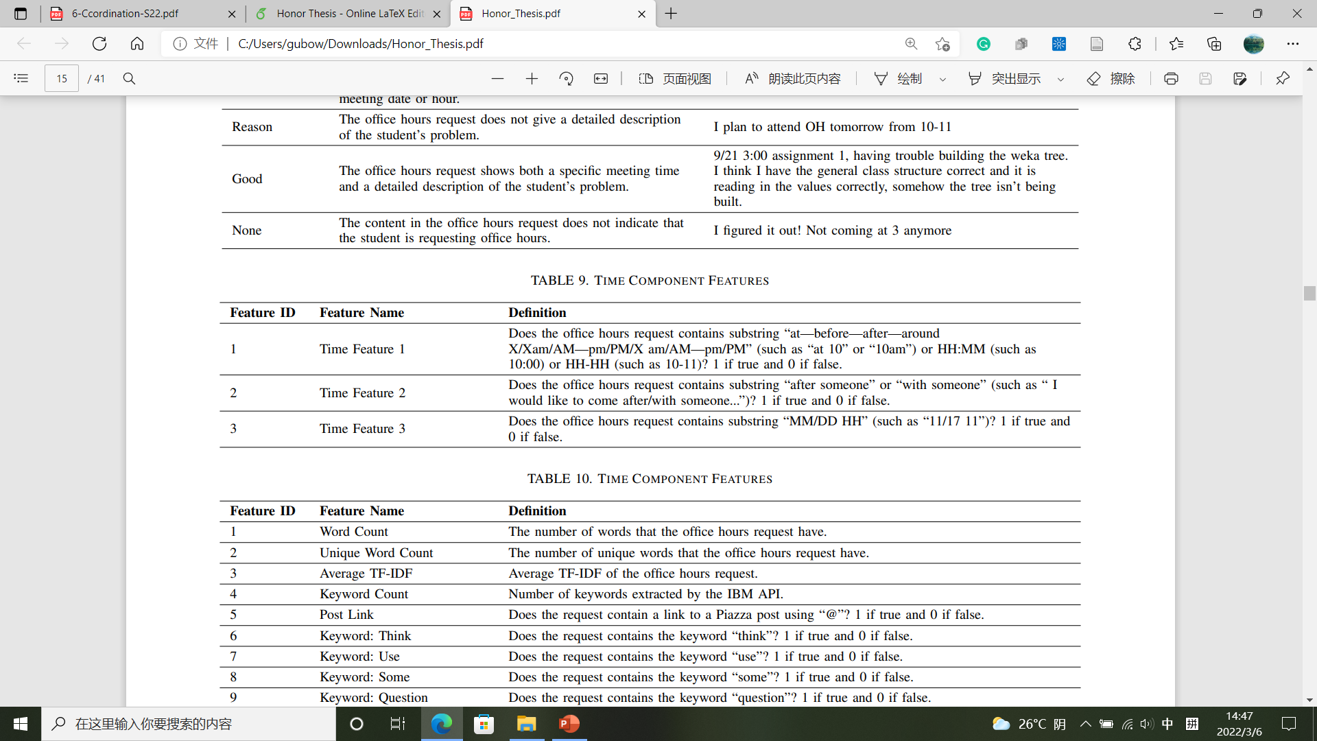
4.3 Incomplete Office Hours Requests Identifier Methodology
4.3.3 Feature Extraction
For definitions, see paper Table 10
Reason Features
For definitions, see paper Table 9
Time Features
Not many features
PCA

Slide 54
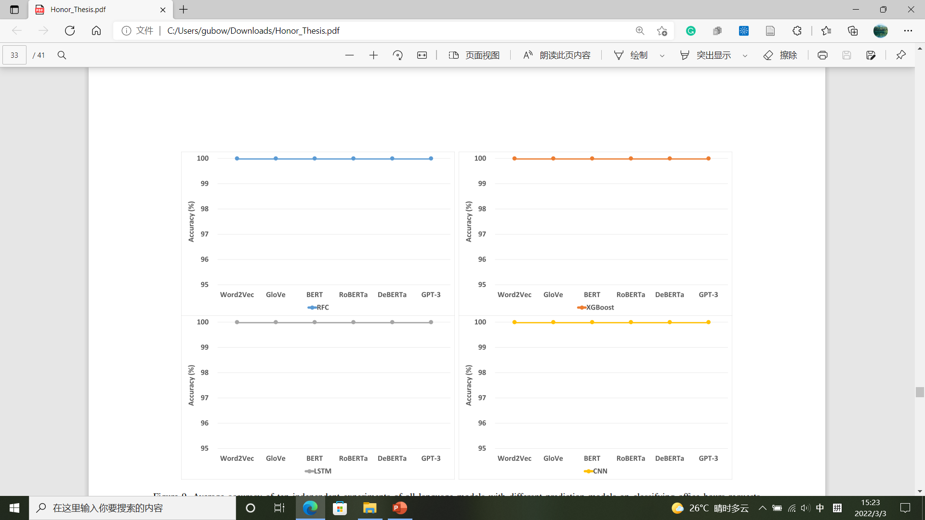
5.3 Incomplete Office Hours Requests Identifier Results
Model Accuracy (Time)
All 100%
Features are helpful

Slide 55
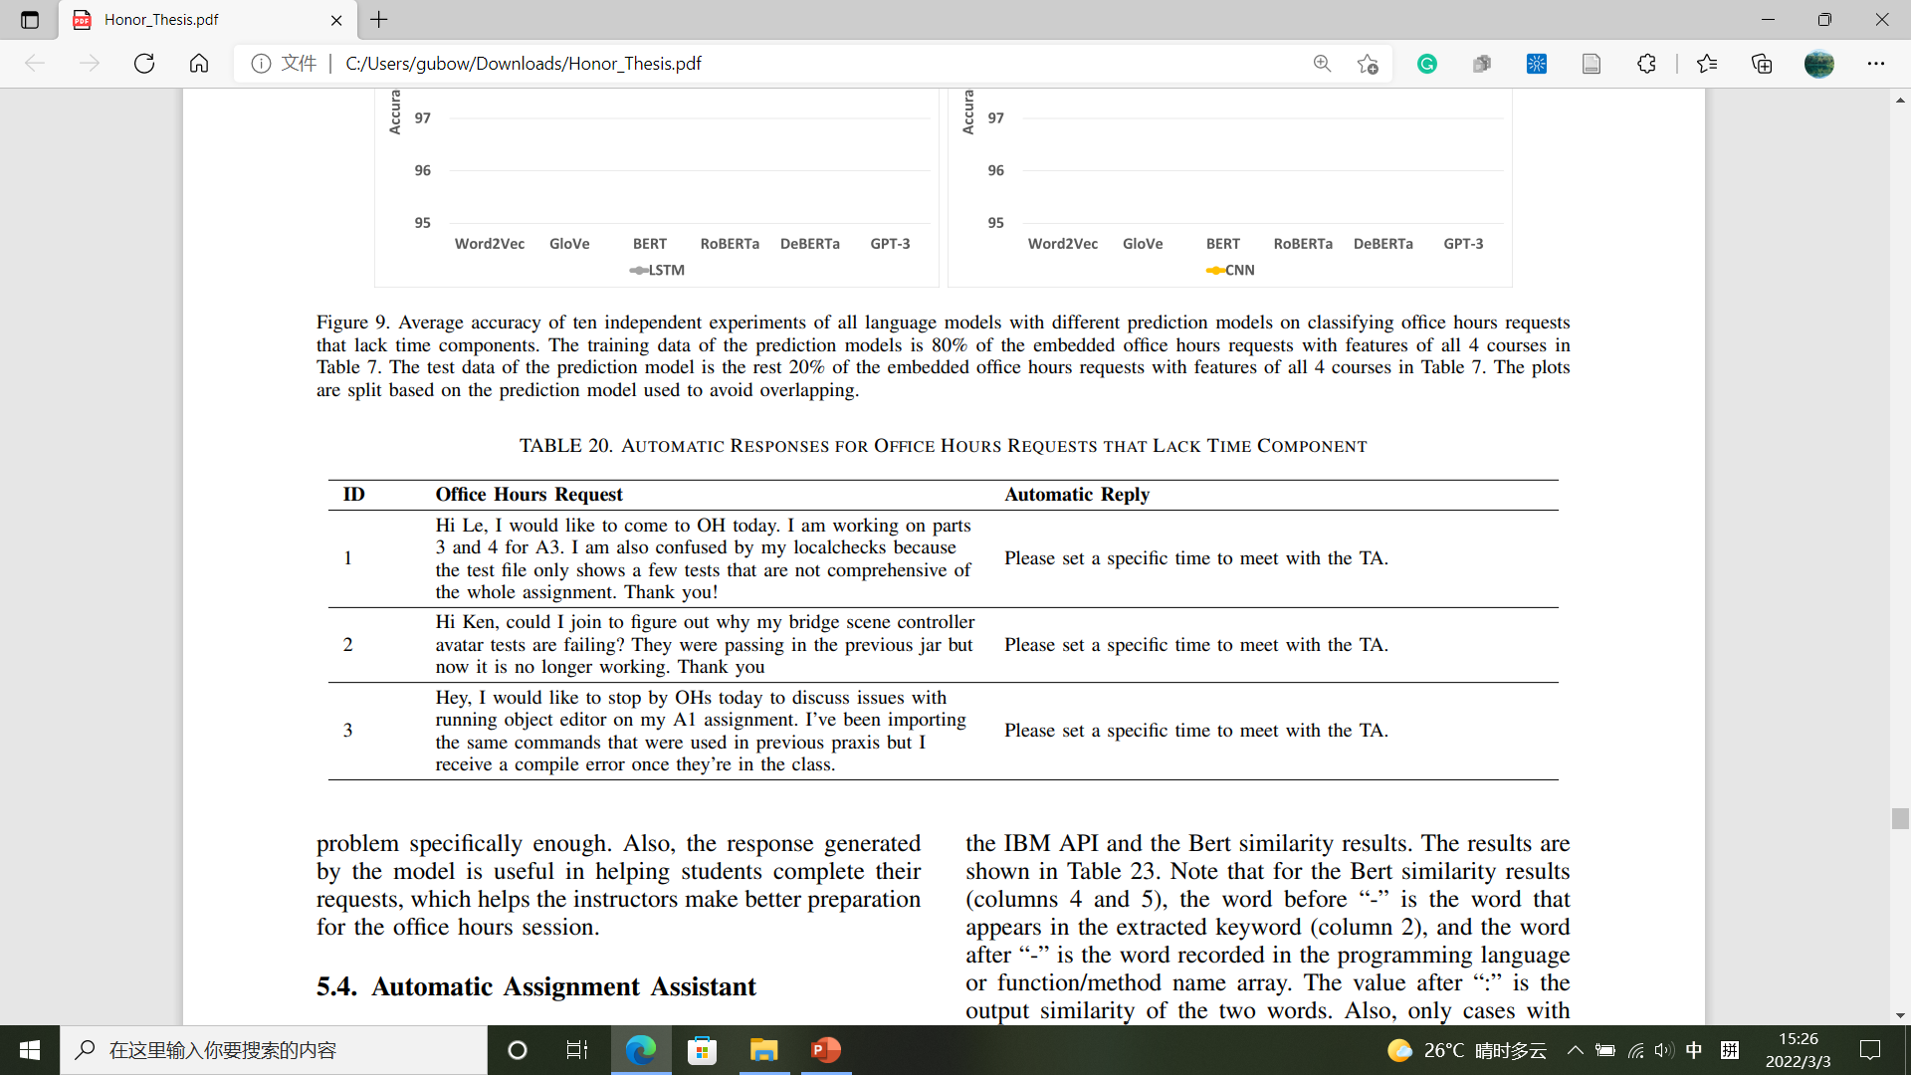
5.3 Incomplete Office Hours Requests Identifier Results
Sample Response (Time)
Specific Time
Specific Reason
Uniform Reply

Slide 56
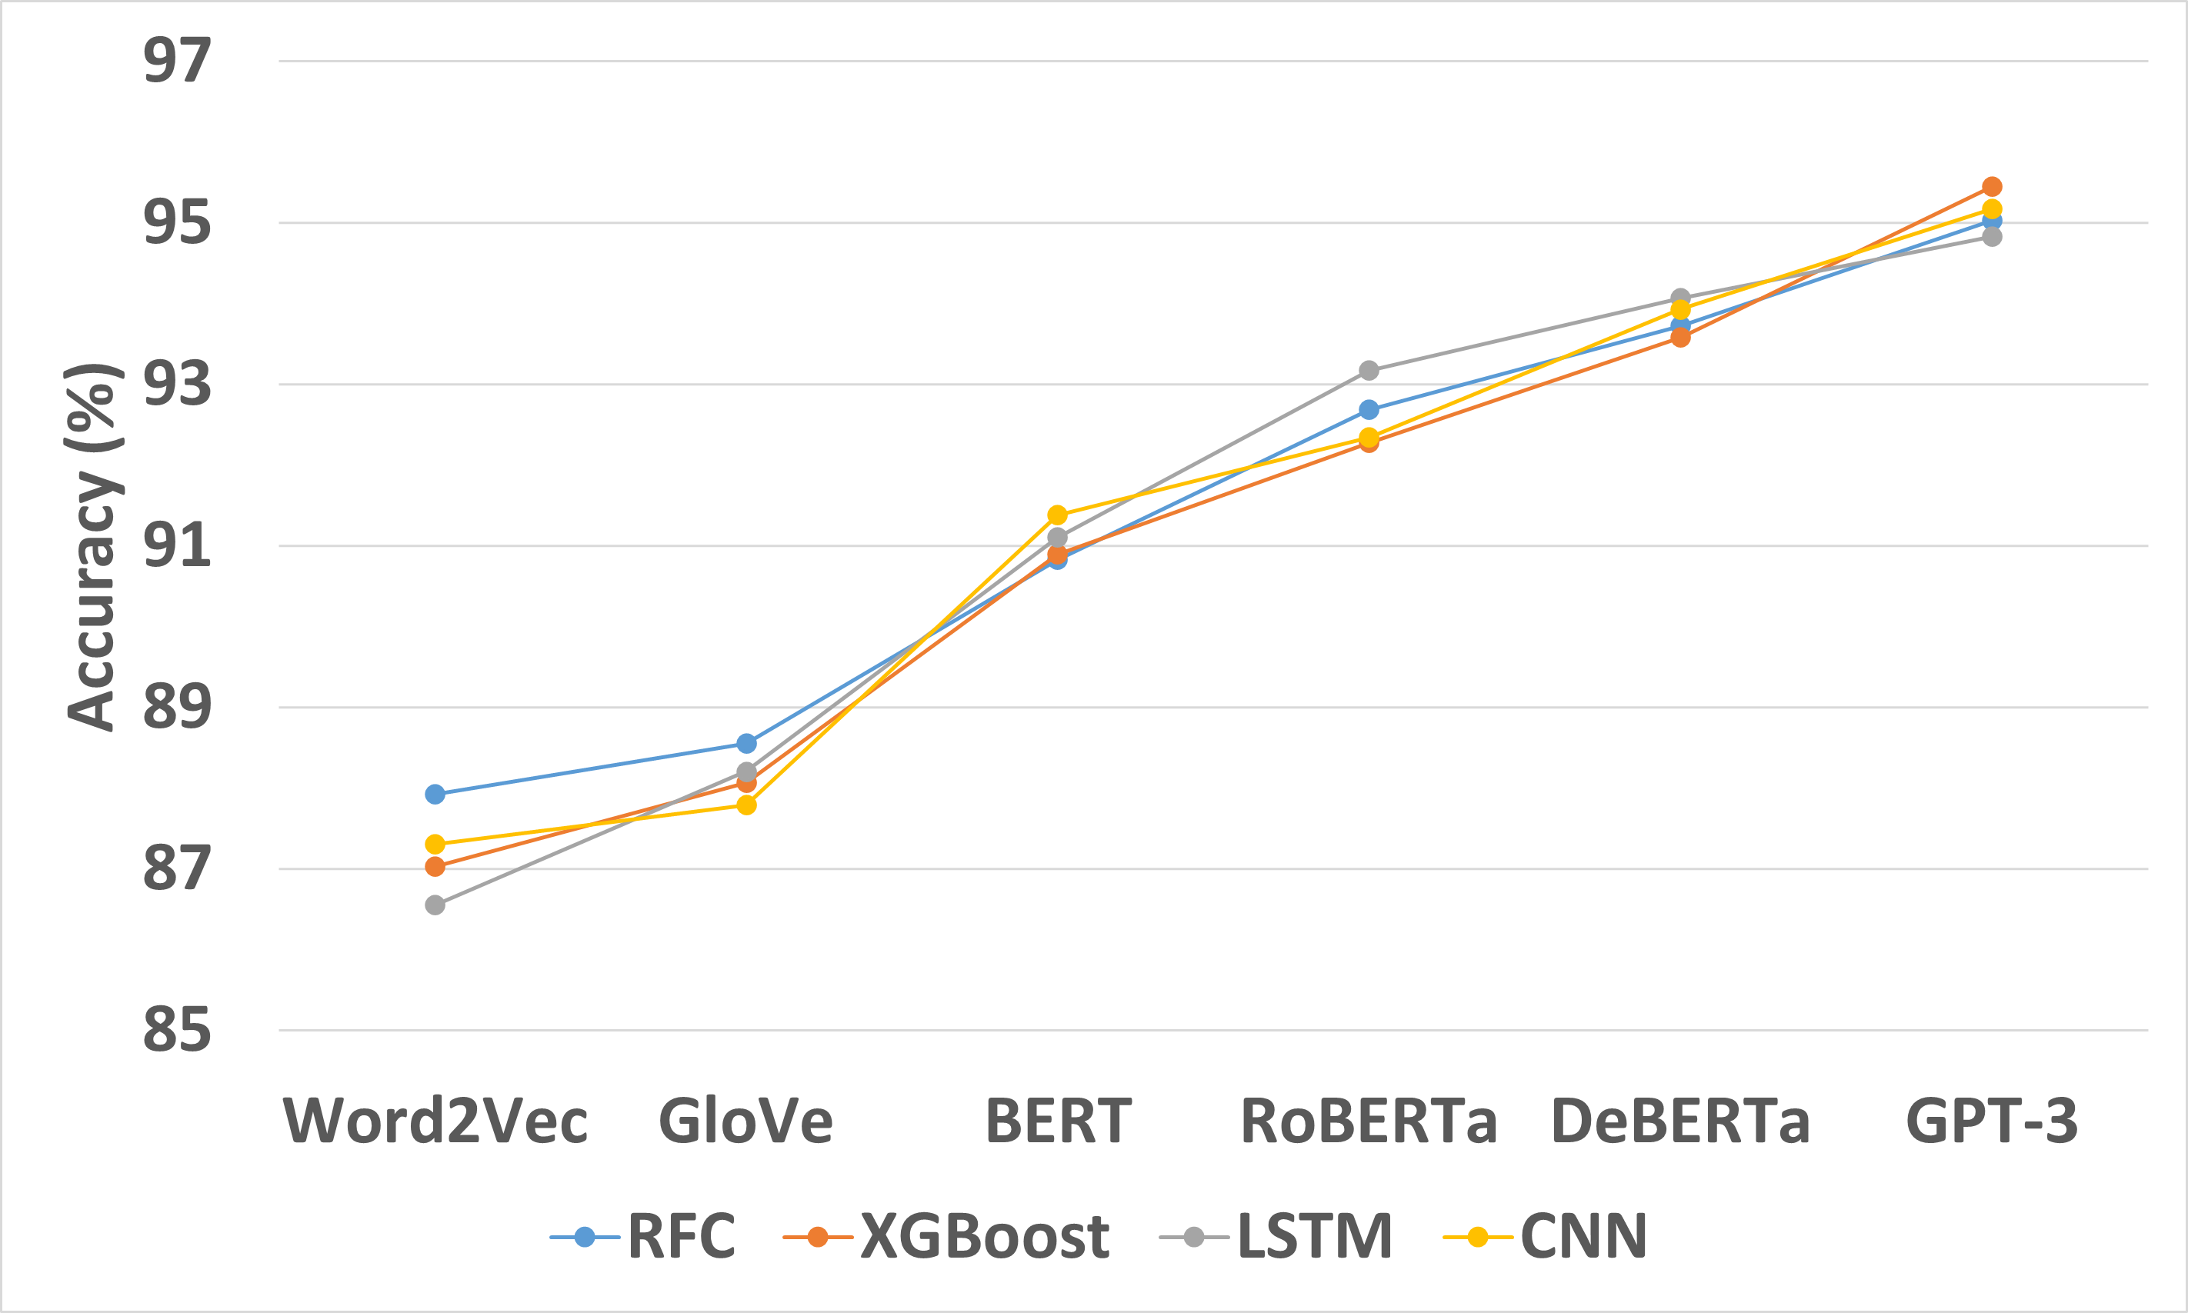
5.3 Incomplete Office Hours Requests Identifier Results
Model Accuracy (Reason)
Language model:
Increase with capability
Accuracy:
Higher than automatic labeling system
Accuracy:
Lower than duplicate posts identifier
Prediction model:
Little difference

Slide 57
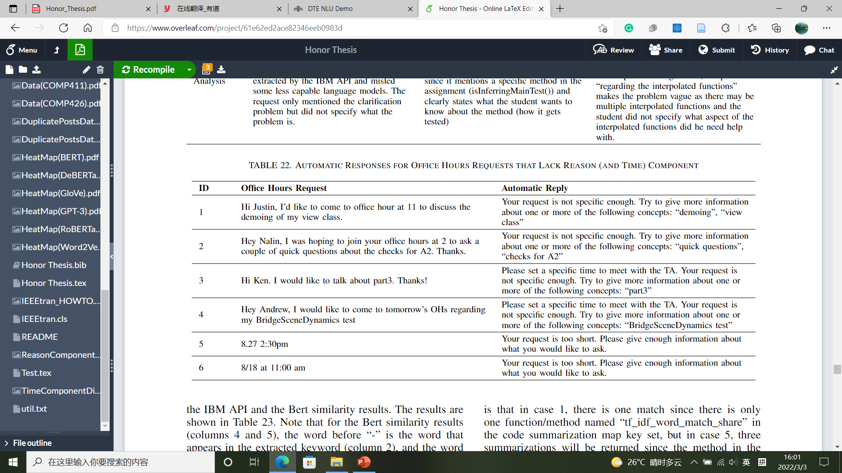
5.3 Incomplete Office Hours Requests Identifier Results
Sample Response (Reason)
IBM Watson
Keyword Extraction
Specific Reason
Customized Reply
Specific Time
Specific Time
Specific Reason
Time + Reason
No Reason
Uniform reply

Slide 58
Kernel
A
B
A: Automatic Labeling System
C
D
B: Duplicate Posts Identifier
C: Incomplete Office Hours
Requests Identifier
Feature Extraction
Prediction Model Set Up
Data Collection
Data Cleaning
Output Predictions
D: Automatic Assignment Assistant

Slide 59
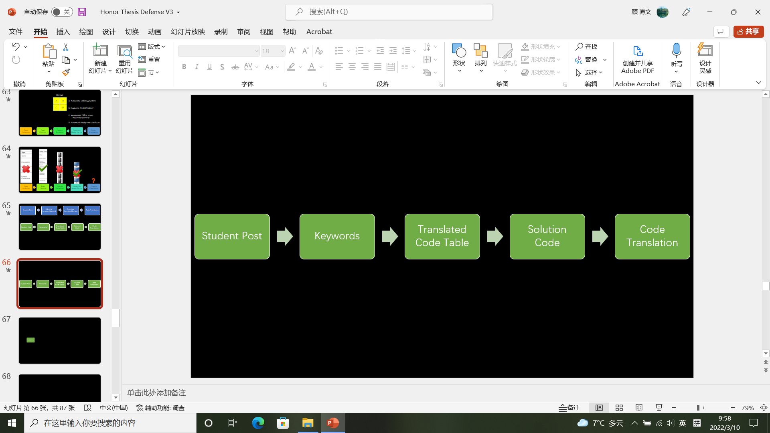
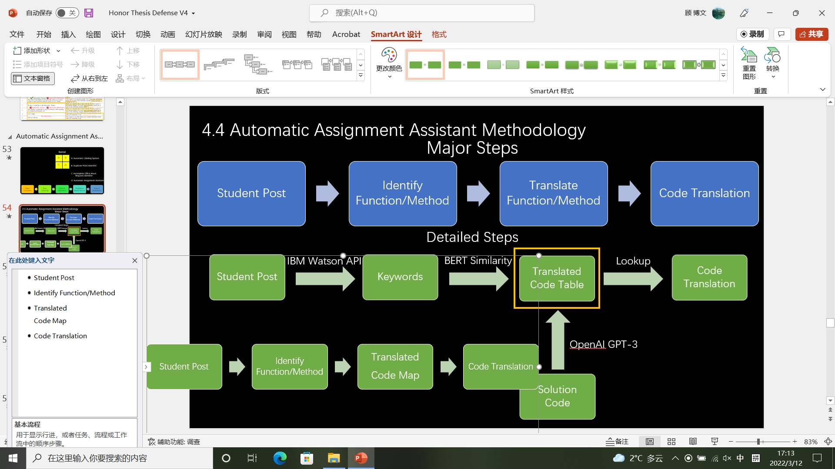
Translate Function/Method
Student Post
Identify Function/Method
Code Translation
4.4 Automatic Assignment Assistant Methodology
Major Steps
Detailed Steps
OpenAI GPT-3

Slide 60
4.4 Automatic Assignment Assistant Methodology
Python Java
C Prolog
SML MIPS
Inform student to specify function/method
Not a code implementation question
[Programming language identifier, function/method identifier]
(String)
(String)
(From student’s post)
(From student’s post)
Map
Code translation
(String)

Slide 61
Translate Function/Method
Student Post
Identify Function/Method
Code Translation
4.4 Automatic Assignment Assistant Methodology
Major Steps
Detailed Steps
IBM Watson API
BERT Similarity
Lookup
OpenAI GPT-3

Slide 62
Translate Function/Method
Student Post
Identify Function/Method
Code Translation
Major Steps

Slide 63
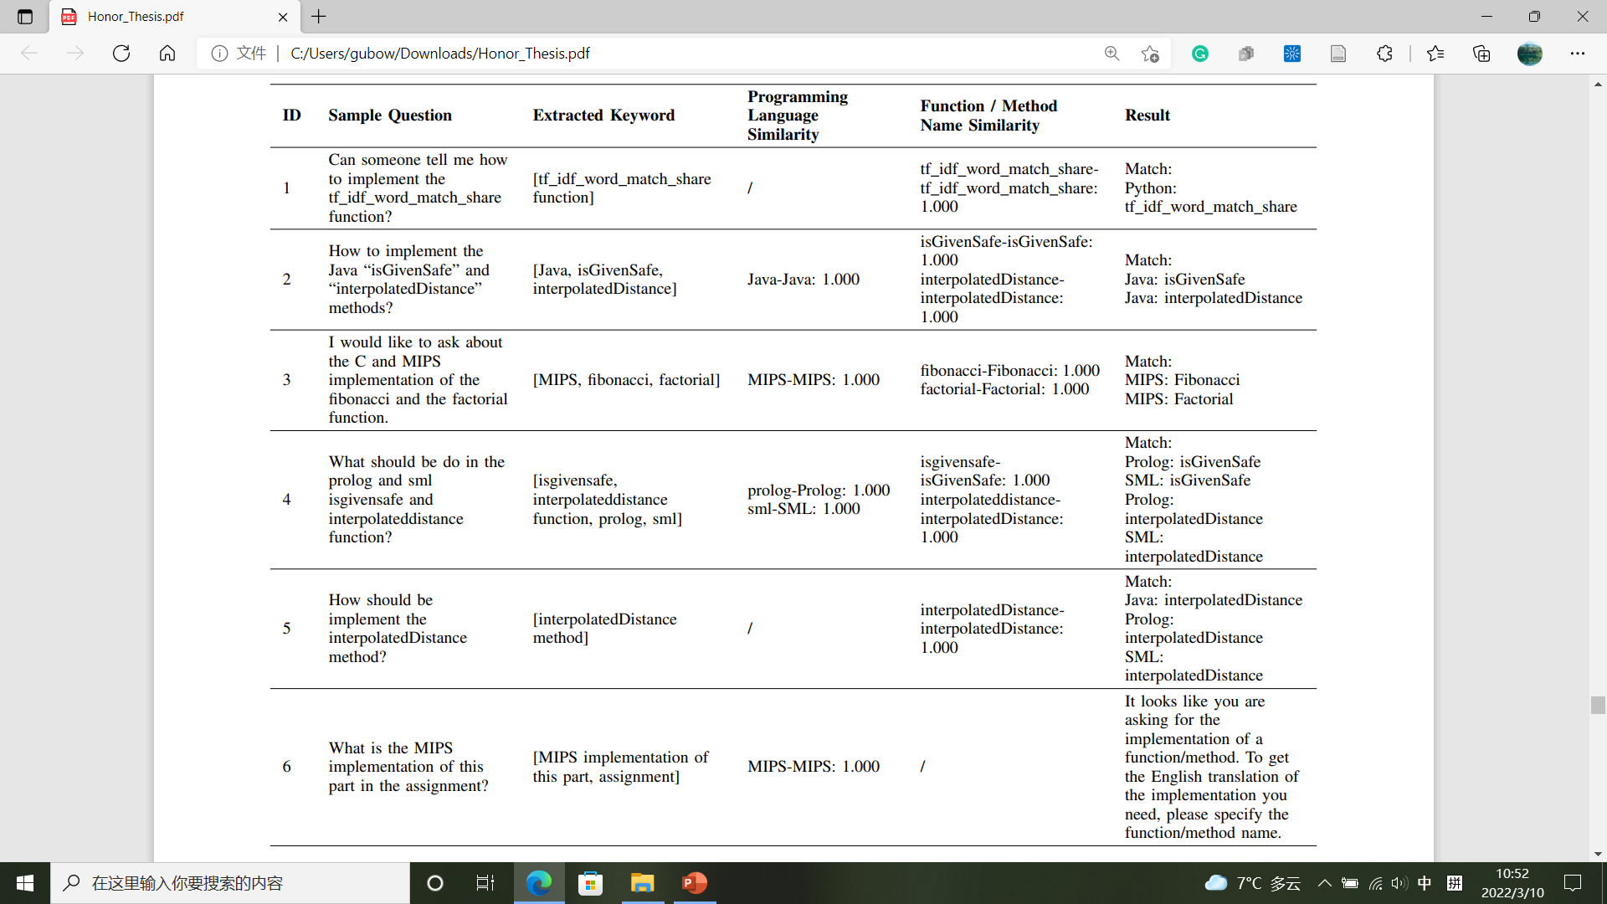
5.4 Automatic Assignment Assistant Results
Identify Function/Method
Programming Language Identifier
Function/Method Identifier
Programming Language Identifier
Function/Method Identifier
Programming Language Identifier
Function/Method Identifier
Programming Language Identifier
Function/Method Identifier

Slide 64
Translate Function/Method
Student Post
Identify Function/Method
Code Translation
Major Steps

Slide 65
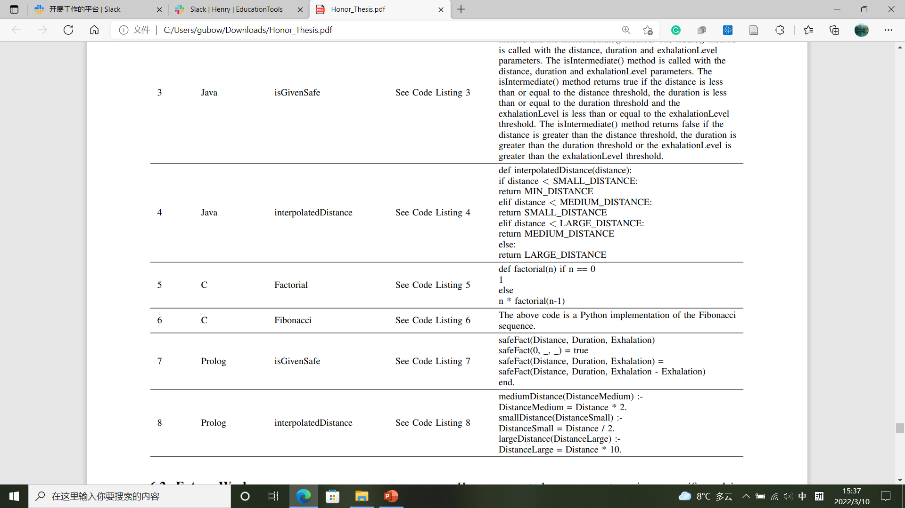
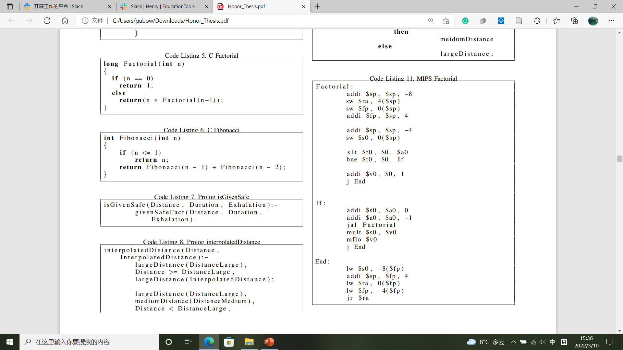
5.4 Automatic Assignment Assistant Results
Translate Function/Method
Rewrite in Python, not translation
Open AI GPT-3

Slide 66
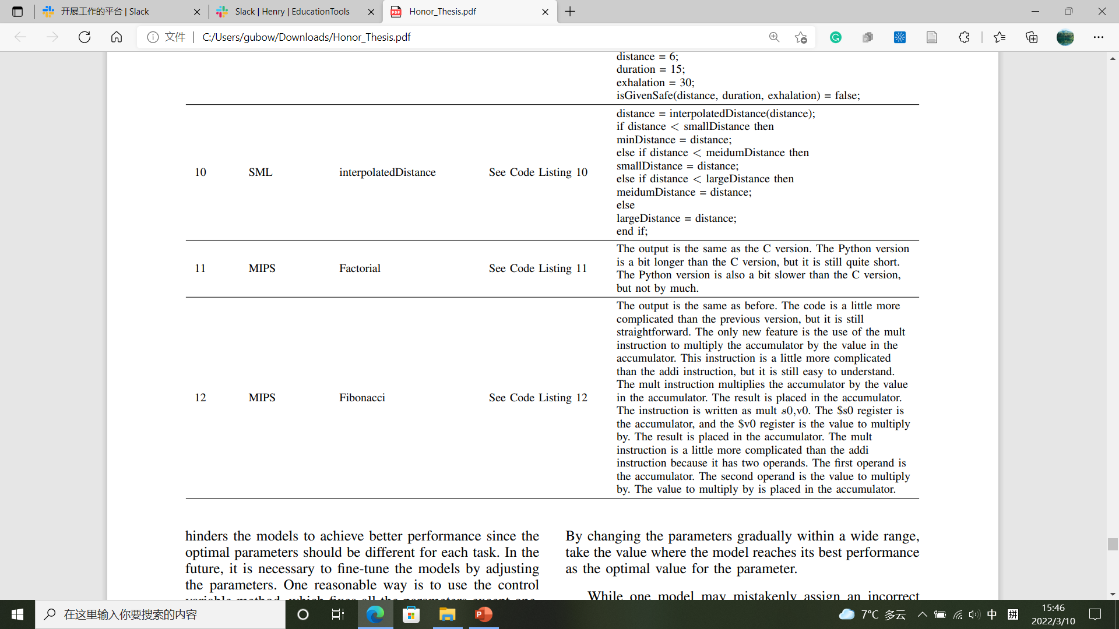
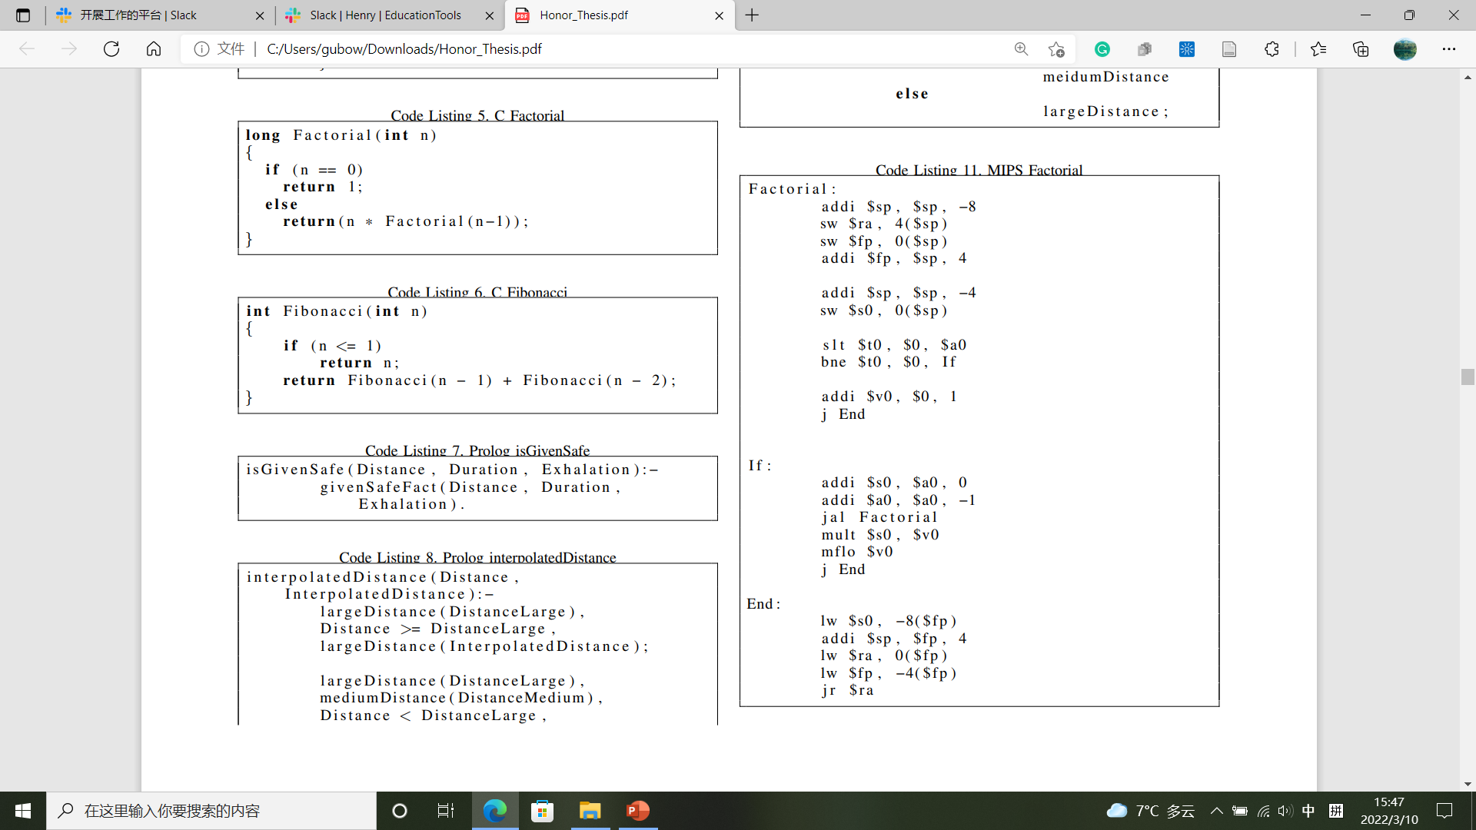
5.4 Automatic Assignment Assistant Results
Translate Function/Method
Translation, but makes no sense
Open AI GPT-3

Slide 67
5.4 Automatic Assignment Assistant Results
Translate Function/Method
Translation makes sense, but wrong and unspecific
Open AI GPT-3

Slide 68
Translate Function/Method
Student Post
Identify Function/Method
Code Translation
Major Steps

Slide 69
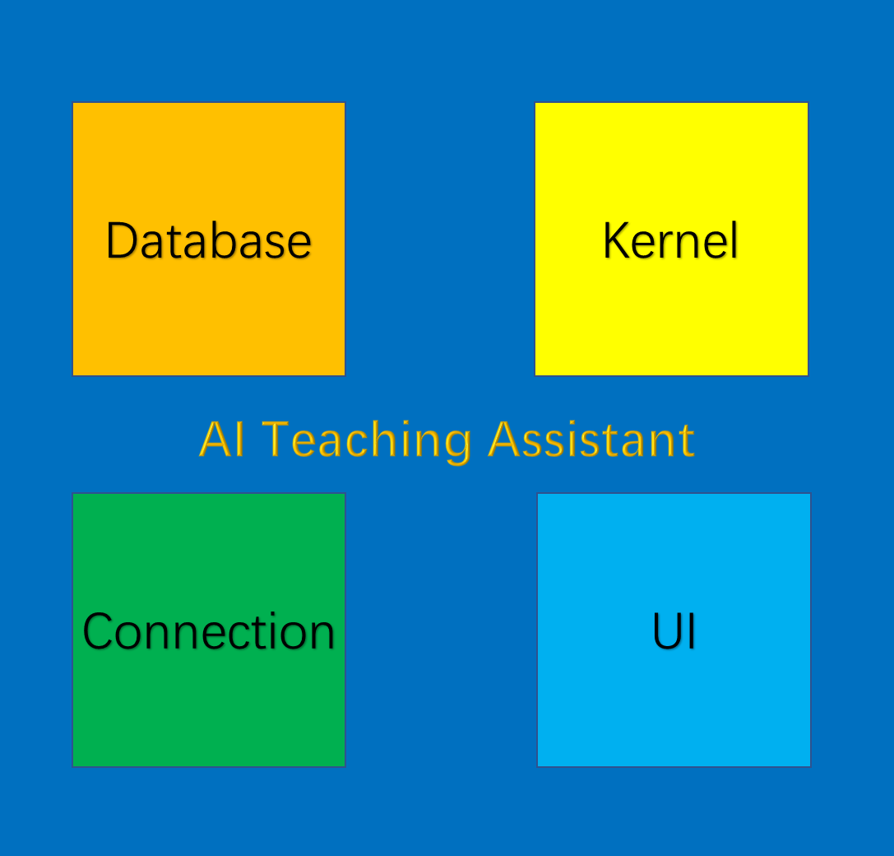
6.1 Conclusion
Overall

Slide 70
6.1 Conclusion
Automatic Labeling System
Highest Accuracy ≈ 90%

Slide 71
6.1 Conclusion
Duplicate Posts Identifier
Highest Accuracy (Quora) ≈ 98.5%

Slide 72
6.1 Conclusion
Duplicate Posts Identifier
Good performance in identifying duplicate Piazza posts,
even for posts in different semesters and complicated posts
Post 1 | Post 2 | Source 1 | Source 2 | Confidence (%)
What should we watch/study to prepare for the midterm on Monday? | I was wondering how I can prepare for the midterm? Should we just look at the quiz and prepare based on it? | COMP 401 Fall 2015 | COMP 401 Fall 2015 | 94.291
Post 1 | Post 2 | Source 1 | Source 2 | Confidence (%)
I keep getting this error: “W***public void grail.ABridgeScene. addPropertyChangeListener (java.beans.PropertyChangeListener) should be associated with annotation: @ObserverRegisterer (Property Listener)” However, when I add the annotation “@ObserverRegisterer(Property Listener)” it keeps giving me errors? | I’m getting the following warnings: W***public void grail.composites.AGorge. addPropertyChangeListener (java.beans.PropertyChangeListener) should be associated with annotation: @ObserverRegisterer (Property Listener). Are we able to safely ignore this without losing points? | COMP 401 Fall 2015 | COMP 401 Fall 2016 | 96.995
Post 1 | Post 2 | Source 1 | Source 2 | Confidence (%)
Does the knight have to “walk” into the gorge or across the bridge, or can it just appear? | Can we make the knight appear on the bridge scene instead of walking across the bridge? | COMP 401 Fall 2013 | COMP 401 Fall 2015 | 96.366

Slide 73
6.1 Conclusion
Incomplete Office Hours Requests Identifier
Highest Accuracy (Time) = 100%
Highest Accuracy (Reason) = 95%

Slide 74
6.1 Conclusion
Incomplete Office Hours Requests Identifier
Good performance on generating automatic reply

Slide 75
6.1 Conclusion
Automatic Assignment Assistant
Translate Function/Method
Student Post
Identify Function/Method
Code Translation
Successfully identify target function/method
Fail to translate target function/method

Slide 76
6.2 Future Work
Fine-tune language models
1. Accuracy improvement
Optimize prediction models’ parameters
Combine prediction models
1. Student Answer Evaluation
2. Model completeness
2. Learning Suggestion
3. Duplicate Posts Identification
4. Incomplete Posts Identification
5. Incomplete Office Hours Requests Identification
3. Functionality expansion
6. Code Assignment Assist
7. Teaching Suggestion
8. Student Performance Prediction
9. …
4. More capable code summarization model
Codex
GPT-3

Slide 77
Acknowledgments
Thank Dr. Prasun Dewan, the advisor of this program, for offering precious guidance and resources.
Thank Dr. John Majikes, the second reader of this paper, for reviewing the paper and offering constructive improvement suggestions.

Slide 78
References
1. Do, J., Dynamic Tagging of Educational Forum PostsUsing NLP Post Embeddings, 2021.
2. Li, Y., Yang, T., Srinivasan, S., Word Embedding for Understanding Natural Language: A Survey, 2018.
3. Devlin, J., Chang, M., Lee, K., Toutanova, K., BERT: Pre-training of Deep Bidirectional Transformers for Language Understanding, 2019.
4. He, P., Liu, X., Gao, J, Chen, W., DeBERTa: Decoding-enhanced BERT with Disentangled Attention, 2021.
5. He, P., Gao, J, Chen, W., DeBERTaV3: Improving DeBERTa using ELECTRA-Style Pre-Training with Gradient-Disentangled Embedding Sharing, 2021.
6. Pennington, J., Socher, R., Manning, C., GloVe: Global Vectors for Word Representation, 2014.
7. Liu, Y., Ott, M., Goyal, N., Du, J., Joshi, M., Chen, D., Levy, O., Lewis, M., Zettlemoyer, L., Stoyanov, V., RoBERTa: A Robustly Optimized BERT Pretraining Approach, 2019.
8. Goldberg, Y., Levy, O., word2vec Explained: deriving Mikolov et al.'s negative-sampling word-embedding method, 2014.
9. Gardner, M., Grus, J., Neumann, M., Tafjord, O., Dasigi, P., Liu, N., Peters, M, Schmitz, M., Zettlemoyer, L., AllenNLP: A Deep Semantic Natural Language Processing Platform, 2018.
10. Zhu, H., Paschalidis, I., Tahmasebi, A., Clinical Concept Extraction with Contextual Word Embedding, 2018.
11. Akbik, A., Bergmann, T., Blythe, D., Rasul, K., Schweter, S., Vollgraf, R., FLAIR: An Easy-to-Use Framework for State-of-the-Art NLP, 2019.
12. Tomas, M., Kai, C., Greg, C., Jeffrey, D., Efficient Estimation of Word Representations in Vector Space, 2013.
13. Tomas, M., Ilya, s., Kai, C., Greg, C., Jeffrey, D., Distributed Representations of Words and Phrases and their Compositionality, 2013.
14. Mnih, A., Hinton, G., Three new graphical models for statistical language modelling, 2007.
15. Koeman, J., Rea, W., How Does Latent Semantic Analysis Work? A Visualisation Approach, 2014.
16. Radford, A., Narasimhan, K., Salimans, T., Sutskever, I., Improving Language Understanding by Generative Pre-Training, 2018.
17. Wang, A., Pruksachatkun, Y., Nangia, N., Singh, A., Michael, J., Hill, F., Levy, O., Bowman, S., SuperGLUE: A Stickier Benchmark for General-Purpose Language Understanding Systems, 2020.
18. Dayhoff, J., Neural network architectures: an introduction, 1990.
19. Dhillon, A., Verma, G., Convolutional neural network: a review of models, methodologies and applications to object detection, 2020.
20. Olien, L., Bélair, J., Bifurcations, stability, and monotonicity properties of a delayed neural network model, 1997.
21. Lipton, Z., Berkowitz, J., Elkan, C., A Critical Review of Recurrent Neural Networks for Sequence Learning, 2015.
22. Yu, Y., Si, X., Hu, C., Zhang, J., A Review of Recurrent Neural Networks: LSTM Cells and Network Architectures, 2019.
23. Hochreiter, S., Schmidhuber, J., Long Short-Term Memory, 1997.
24. Floridi, L., Chiriatti, M., GPT-3: Its Nature, Scope, Limits, and Consequences, 2020.
25. Dale, R., GPT-3: What’s it good for?, 2021.
26. Radford, A., Wu, J., Child, R., Luan, D., Amodei, D., Sutskever, I., Language Models are Unsupervised Multitask Learners, 2019.
27. Tom B., B., Mann, B., Ryder, N., Subbiah, M., Kaplan, J., Dhariwal, P., Neelakantan, A. et al, Language models are few-shot learners, 2020.
28. Vaswani, A., Shazeer, N., Parmar, N., Uszkoreit, J., Jones, L., Gomez, A., Kaiser, L., Polosukhin, I., Attention is All you Need, 2017.
29. Rajeswaran, A., Finn, C., Kakade, S., Levine, S., Meta-Learning with Implicit Gradients, 2019.
30. Finn, C., Abbeel, P., Levine, S., Model-Agnostic Meta-Learning for Fast Adaptation of Deep Networks, 2017.
31. Chen, M., Tworek, J., Jun, H., Yuan, Q., Pinto, H. et al, Evaluating Large Language Models Trained on Code, 2021.
32. Vellukunnel, M., Buffum, P., Boyer, K., Forbes, J., Heckman, S., Mayer-Patel, K. et al, Deconstructing the Discussion Forum: Student Questions and Computer Science Learning, 2017.
33. Chaturvedi, S., Goldwasser, D., Daumé III, H., Predicting Instructor's Intervention in MOOC forums, 2014.
34. Zhang, W., Sheng, Q., Lau, J., Abebe, E., Detecting Duplicate Posts in Programming QA Communities via Latent Semantics and Association Rules, 2017.
35. Ahasanuzzaman, M., Asaduzzaman, M., Roy, C., Schneider, K., Mining Duplicate Questions of Stack Overflow, 2016.
36. Hindle, A., Barr, E., Gabel, M., Su, Z., Devanbu, P., On the naturalness of software, 2016.
37. Ray, B., Hellendoorn, V., Godhane, S., Tu, Z., Bacchelli, A., Devanbu, P., On the ``Naturalness" of Buggy Code, 2016.
38. Bansal, A., Haque, S., McMillan, C., Project-Level Encoding for Neural Source Code Summarization of Subroutines, 2021.
39. Haque, S., LeClair, A., Wu, L., McMillan, C., Improved Automatic Summarization of Subroutines via Attention to File Context, 2020.
40. LeClair, A., Haque, S., Wu, L., McMillan, C., Improved Code Summarization via a Graph Neural Network, 2020.
41. Ahmad, W., Chakraborty, S., Ray, B., Chang, K., A Transformer-based Approach for Source Code Summarization, 2020.
42. Chen, T., Guestrin, C., XGBoost: A Scalable Tree Boosting System, 2016.
43. Swain, P., Hauska, H., The decision tree classifier: Design and potential, 1977.
44. Liaw, A., Wiener, M., Classiﬁcation and Regression by randomForest, 2002.
45. Sagi, O., Rokach, L., Ensemble learning: A survey, 2018.
46. Lewis, R., An Introduction to Classification and Regression Tree (CART) Analysis, 2000.

